Slide 1
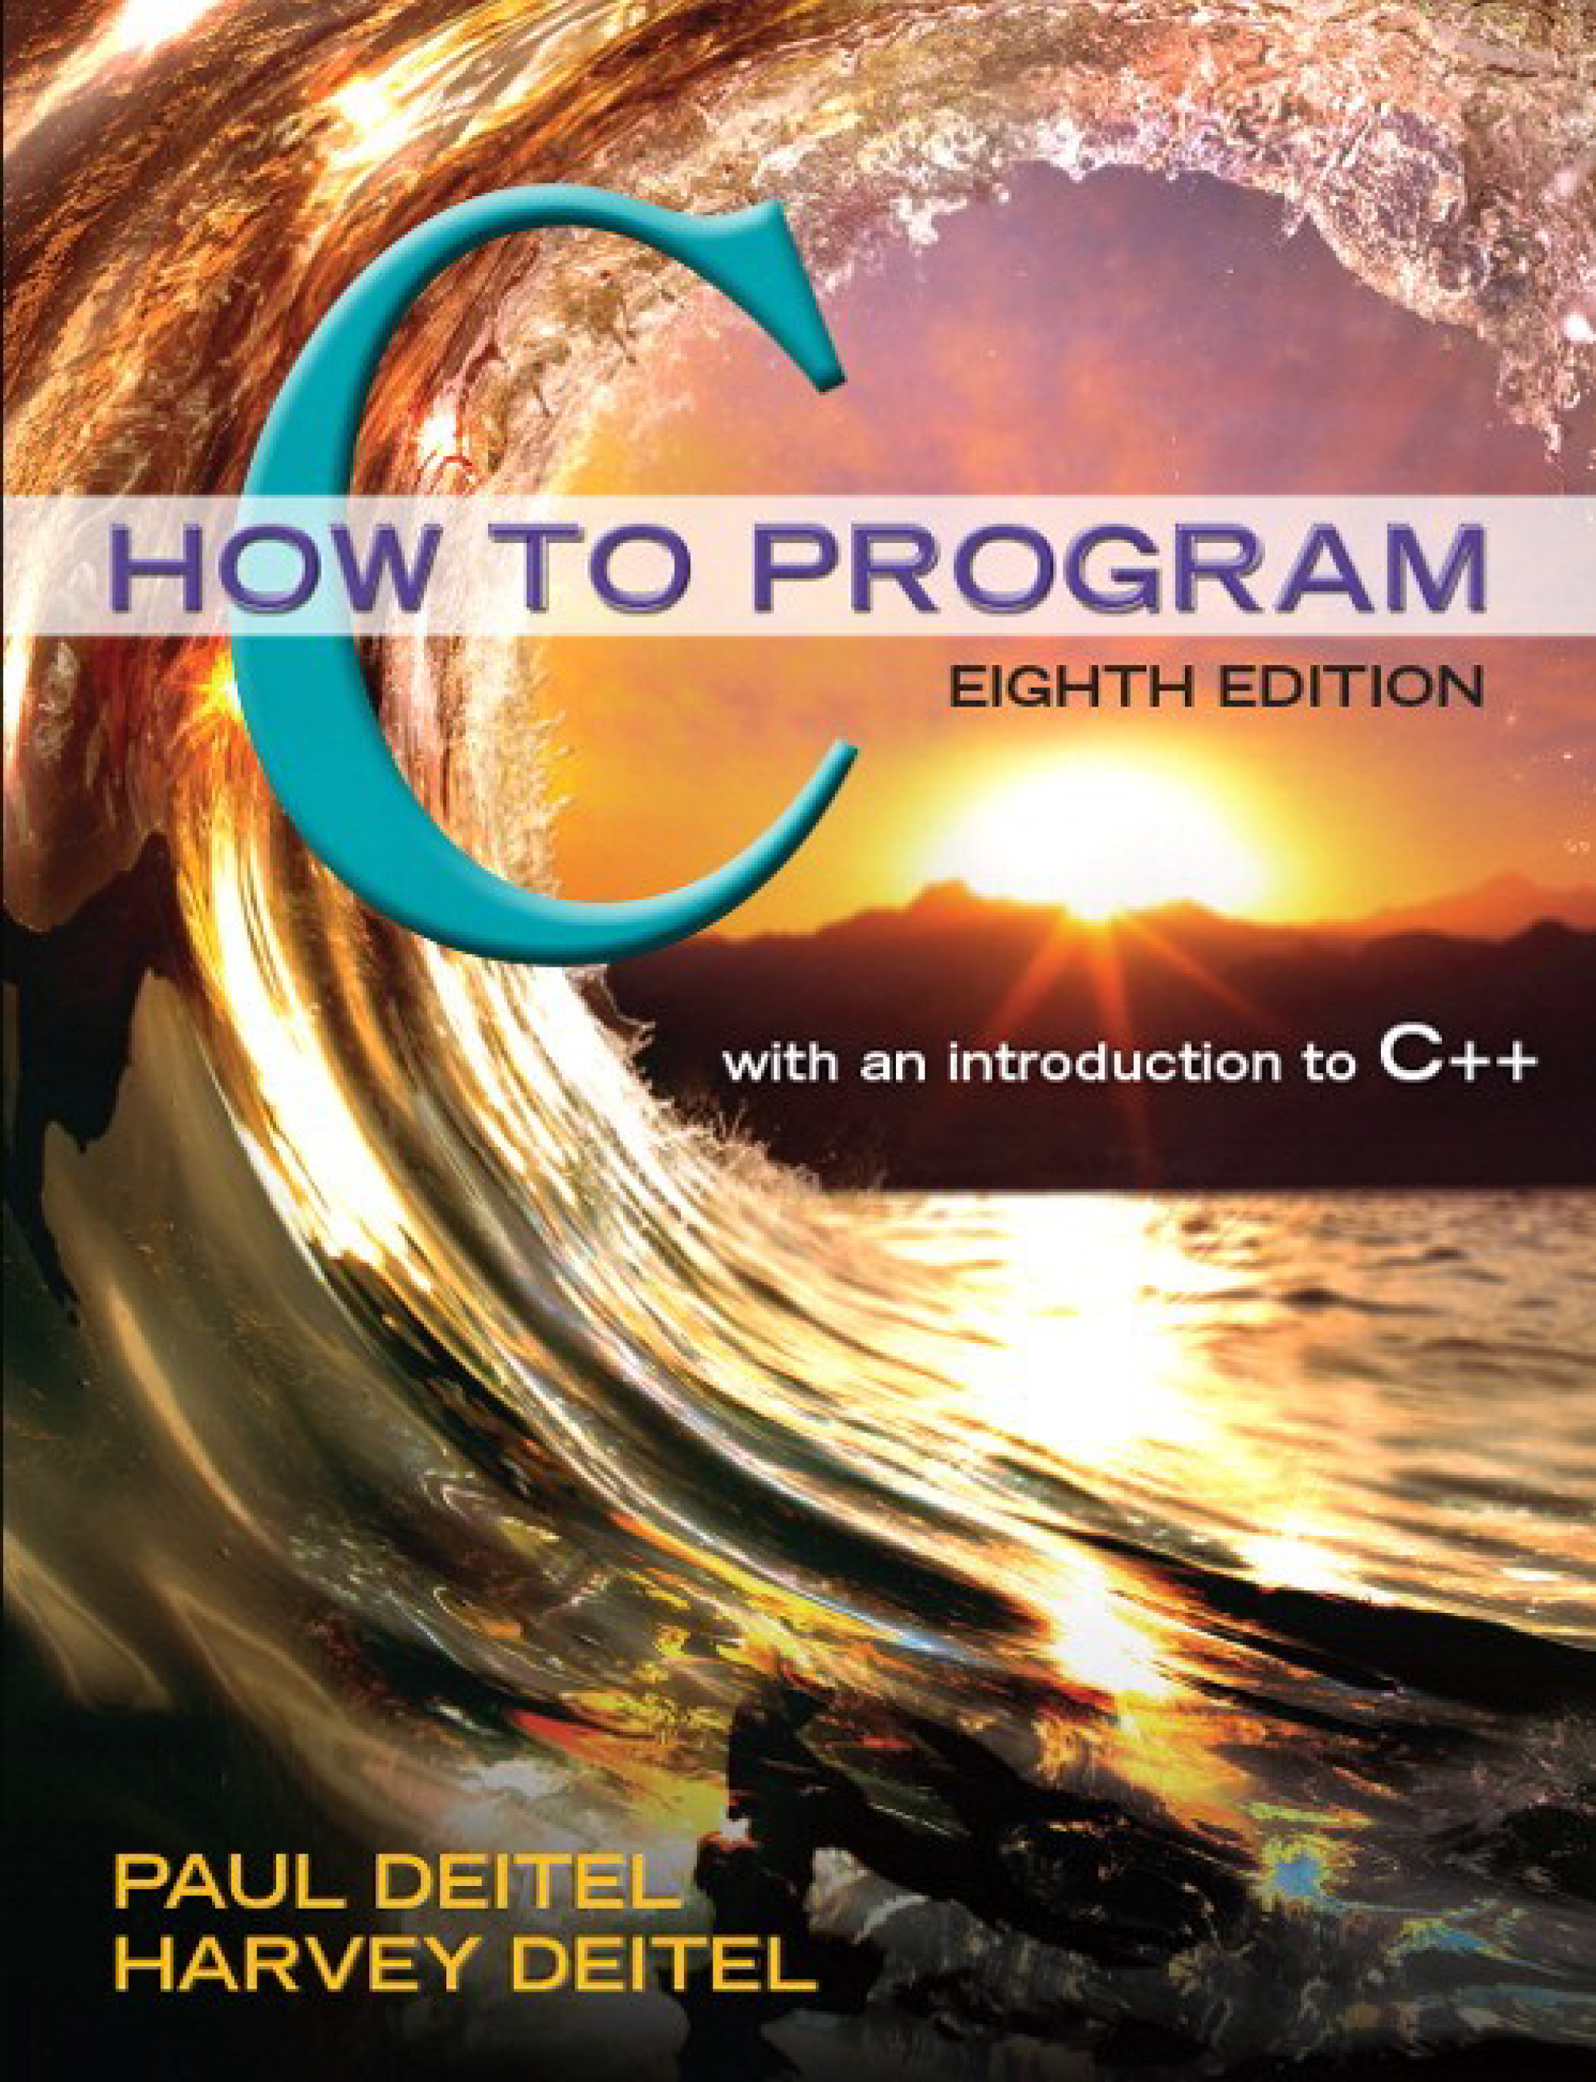
C How to Program
Eighth Edition
Chapter 18
Operator Overloading; Class string
Copyright © 2016, 2013, 2010 Pearson Education, Inc. All Rights Reserved
Notes:
If this PowerPoint presentation contains mathematical equations, you may need to check that your computer has the following installed:
1) MathType Plugin
2) Math Player (free versions available)
3) NVDA Reader (free versions available)

Slide 2
Learning Objectives
Learn how operator overloading can help you craft valuable classes.
Overload unary and binary operators.
Convert objects from one class to another class.
Use overloaded operators and additional features of the string class.
Create Phone Number, Date and Array classes that provide overloaded operators.
Perform dynamic memory allocation with new and delete.
Use keyword explicit to indicate that a constructor cannot be used for implicit conversions.
Experience a “light-bulb moment” when you’ll truly appreciate the elegance and beauty of the class concept.

Slide 3
Outline (1 of 2)
18.1 Introduction
18.2 Using the Overloaded Operators of Standard Library Class string
18.3 Fundamentals of Operator Overloading
18.4 Overloading Binary Operators
18.5 Overloading the Binary Stream Insertion and Stream Extraction Operators
18.6 Overloading Unary Operators
18.7 Overloading the Unary Prefix and Postfix
18.8 Case Study: A Date Class
18.9 Dynamic Memory Management

Slide 4
Outline (2 of 2)
18.10 Case Study: Array Class
18.10.1 Using the Array Class
18.10.2 Array Class Definition
18.11 Operators as Member versus. Non-Member Functions
18.12 Converting Between Types
18.13 explicit Constructors and Conversion Operators
18.14 Overloading the Function Call Operator ()
18.15 Wrap-Up

Slide 5
18.1 Introduction
This chapter shows how to enable C++’s operators to work with objects—a process called operator overloading.
One example of an overloaded operator built into C++ is,
which is used both as the stream insertion operator and as the bitwise left-shift operator.
C++ overloads the addition operator (+) and the subtraction operator (−) to perform differently, depending on their context in integer, floating-point and pointer arithmetic with data of fundamental types.
You can overload most operators to be used with class objects—the compiler generates the appropriate code based on the types of the operands.

Slide 6
18.2 Using the Overloaded Operators of Standard Library Class string (1 of 4)
Figure 18.1 demonstrates many of class string’s overloaded operators and several other useful member functions, including empty, sub s t r and at.
Function empty determines whether a string is empty, function sub s t r returns a string that represents a portion of an existing string and function at returns the character at a specific index in a string (after checking that the index is in range).
Chapter 21 presents class string in detail.

Slide 7
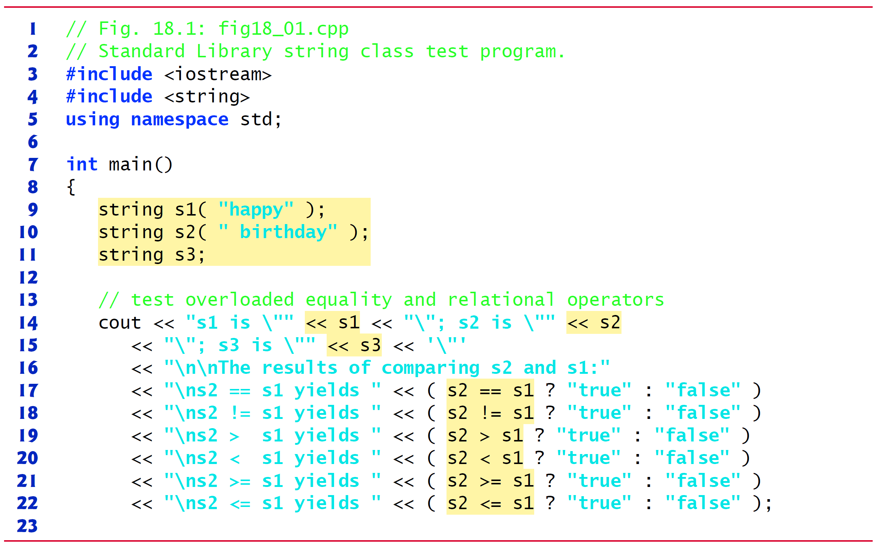
Figure 18.1 Standard Library string Class Test Program (1 of 6)

Slide 8
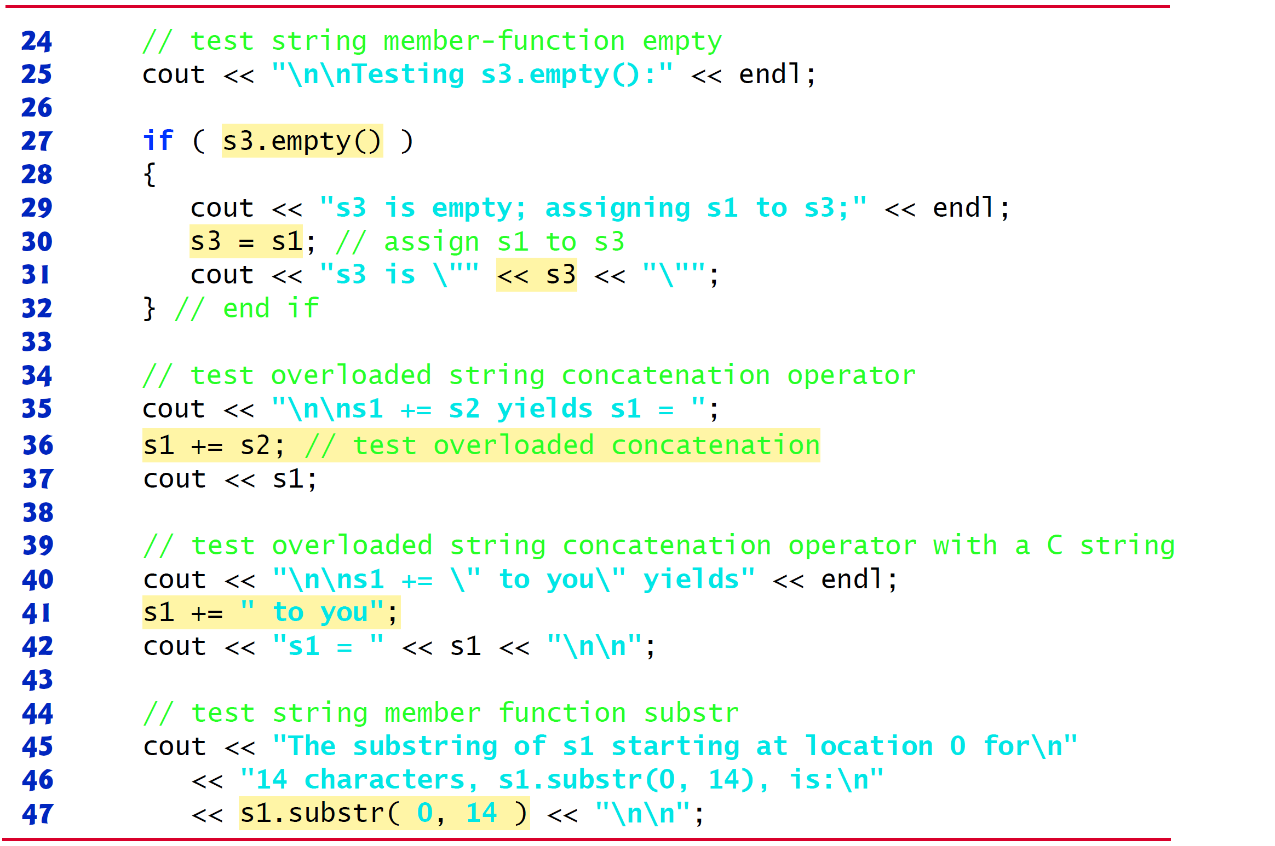
Figure 18.1 Standard Library string Class Test Program (2 of 6)

Slide 9
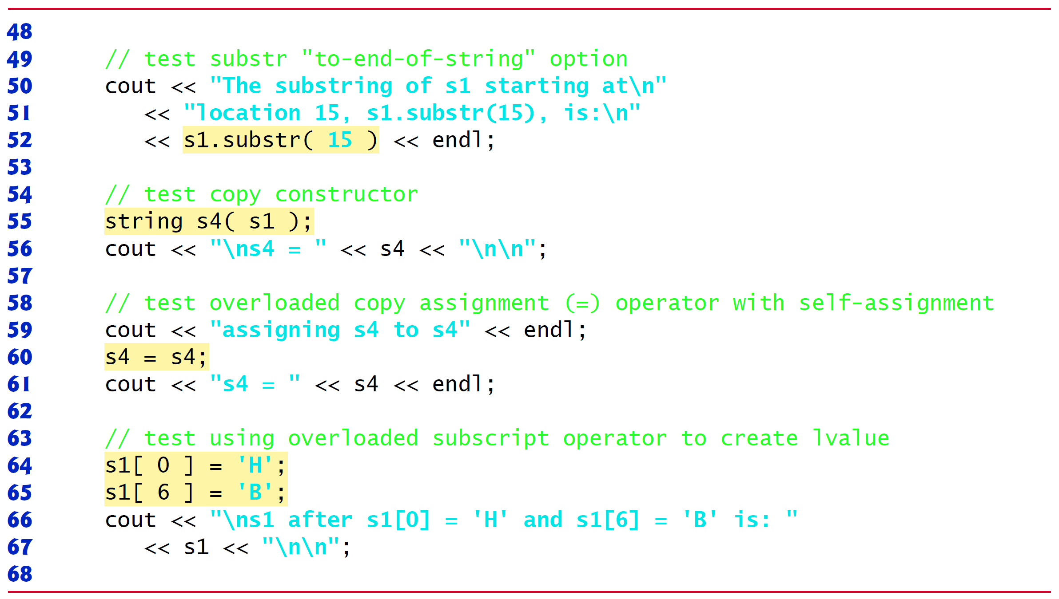
Figure 18.1 Standard Library string Class Test Program (3 of 6)

Slide 10
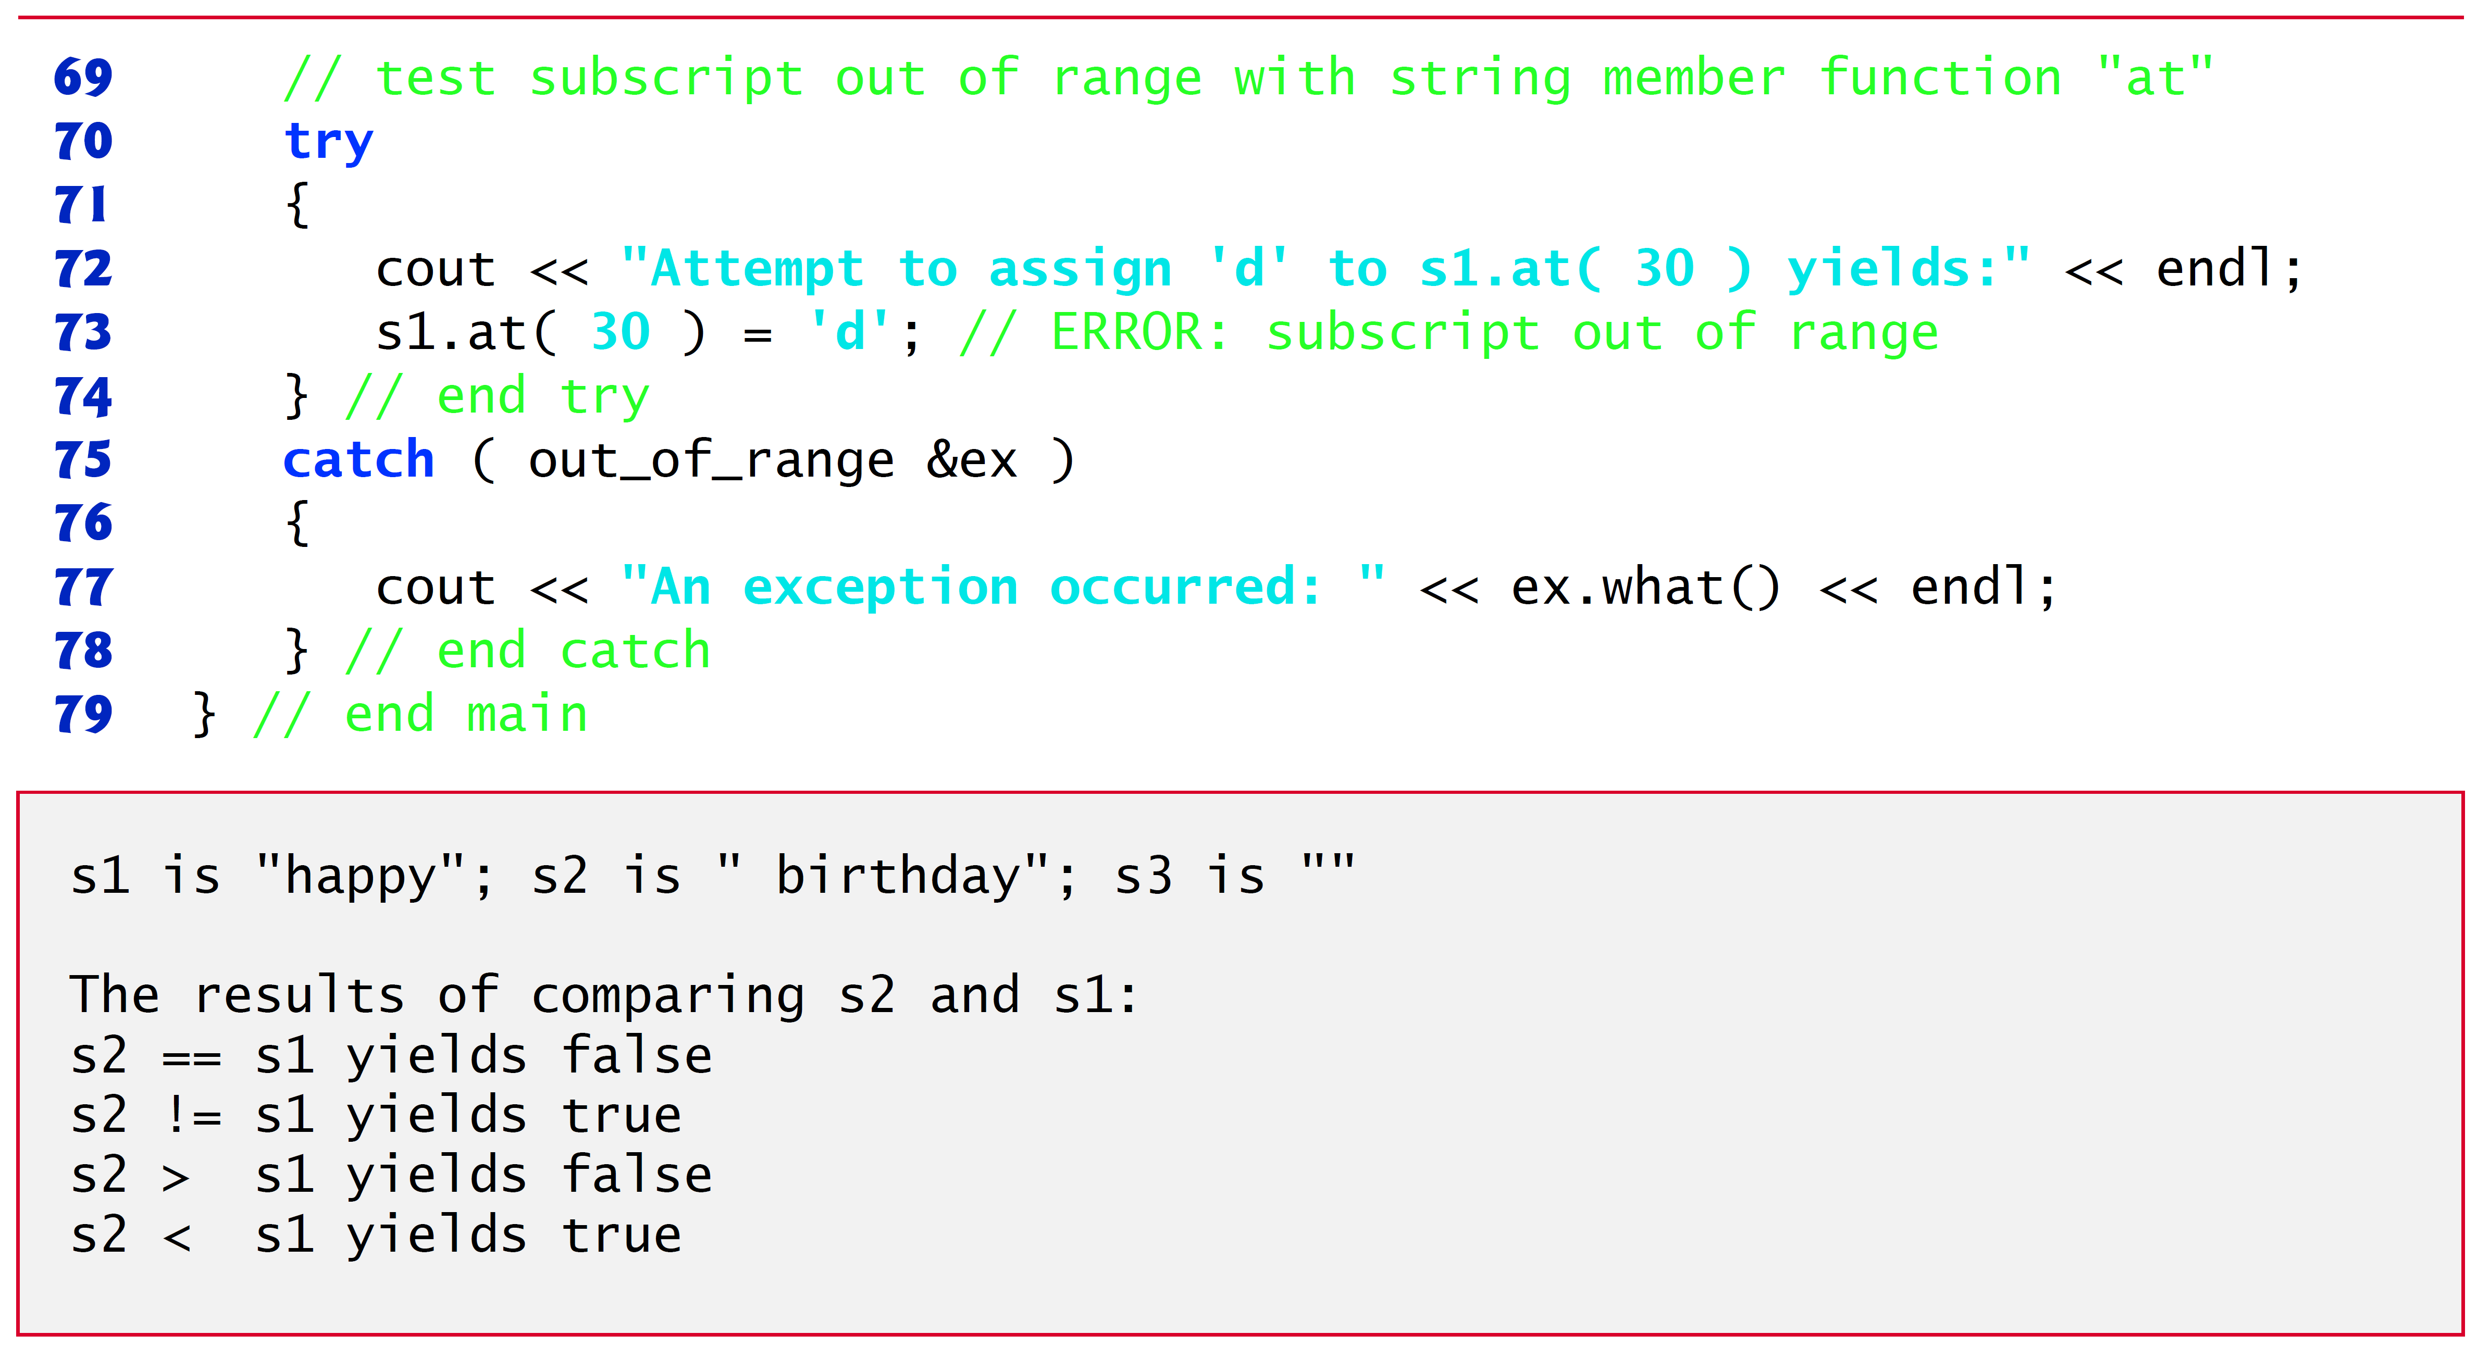
Figure 18.1 Standard Library string Class Test Program (4 of 6)

Slide 11
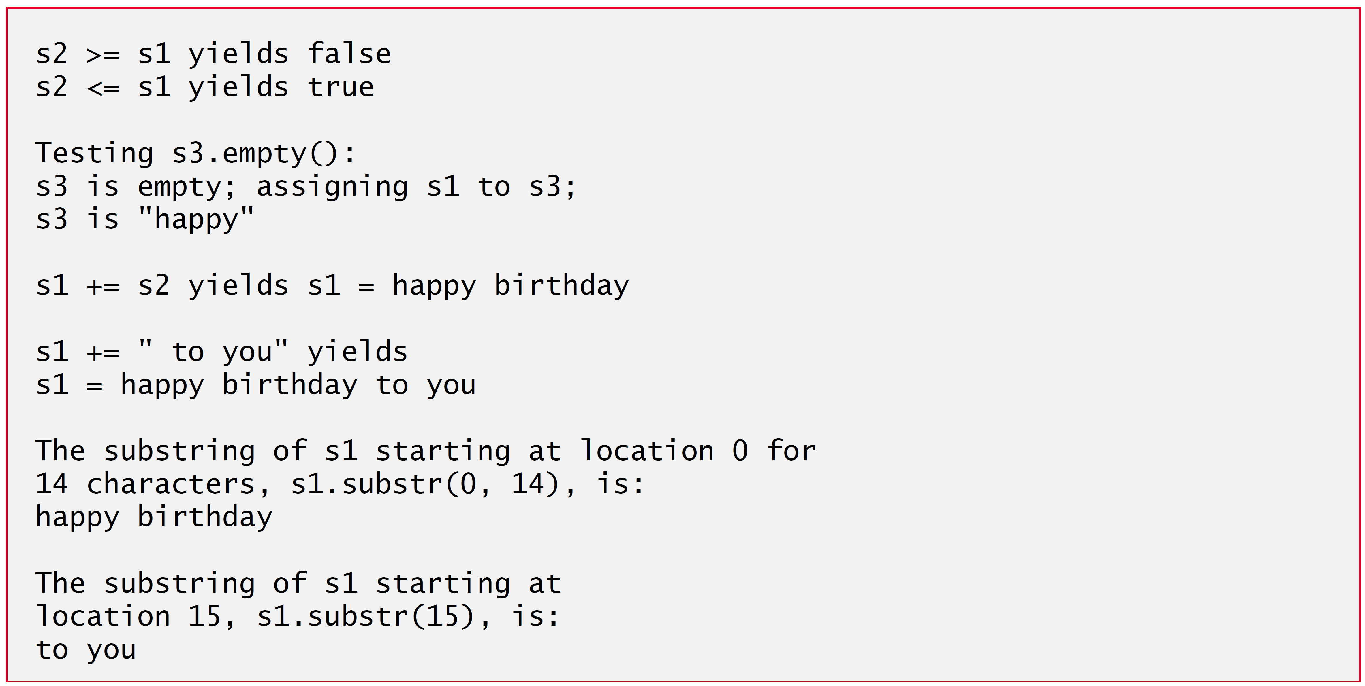
Figure 18.1 Standard Library string Class Test Program (5 of 6)

Slide 12
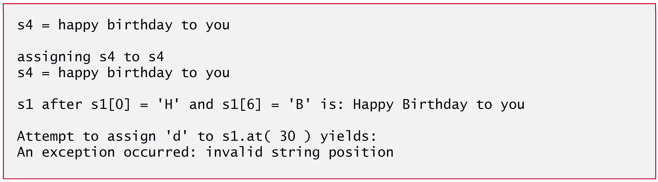
Figure 18.1 Standard Library string Class Test Program (6 of 6)

Slide 13
18.2 Using the Overloaded Operators of Standard Library Class string (2 of 4)
Class string’s overloaded equality and relational operators perform lexicographical comparisons (i.e., like a dictionary ordering) using the numerical values of the characters (see Appendix B, ASCII Character Set) in each string.
Class string provides member function empty to determine whether a string is empty, which we demonstrate in line 27.
Returns true if the string is empty; otherwise, it returns false.
Line 36 demonstrates class string’s overloaded
operator for string concatenation.
Line 41 demonstrates that a string literal can be appended to a string object by using operator
Line 42 displays the result.

Slide 14
18.2 Using the Overloaded Operators of Standard Library Class string (3 of 4)
Class string provides member function substr (lines 47 and 52) to return a portion of a string as a string object.
The call to substr in line 47 obtains a 14-character substring (specified by the second argument) of s1 starting at position 0 (specified by the first argument).
The call to substr in line 52 obtains a substring starting from position 15 of s1.
When the second argument is not specified, substr returns the remainder of the string on which it’s called.
Lines 64-65 use class string’s overloaded [] operator can create l values that enable new characters to replace existing characters in s1.
Class string’s overloaded [] operator does not perform any bounds checking.

Slide 15
18.2 Using the Overloaded Operators of Standard Library Class string (4 of 4)
Class string does provide bounds checking in its member function at, which throws an exception if its argument is an invalid subscript.
If the subscript is valid, function at returns the character at the specified location as a modifiable l value or a nonmodifiable l value (e.g., a const reference), depending on the context in which the call appears.

Slide 16
18.3 Fundamentals of Operator Overloading (1 of 7)
As you saw in Figure 18.1 (see slides 7-12), operators provide a concise notation for manipulating string objects.
You can use operators with your own user-defined types as well.
Although C++ does not allow new operators to be created, it does allow most existing operators to be overloaded so that, when they’re used with objects, they have meaning appropriate to those objects.

Slide 17
18.3 Fundamentals of Operator Overloading (2 of 7)
Operator overloading is not automatic—you must write operator-overloading functions to perform the desired operations.
An operator is overloaded by writing a non-static member function definition or non-member function definition as you normally would, except that the function name starts with the keyword operator followed by the symbol for the operator being overloaded.
For example, the function name operator+ would be used to overload the addition operator (+) for use with objects of a particular class (or enum).

Slide 18
18.3 Fundamentals of Operator Overloading (3 of 7)
When operators are overloaded as member functions, they must be non-static, because they must be called on an object of the class and operate on that object.
To use an operator on class objects, you must define overloaded operator functions for that class—with three exceptions.
The assignment operator (=) may be used with most classes to perform member wise assignment of the data members—each data member is assigned from the assignment’s “source” object (on the right) to the “target” object (on the left).
Member wise assignment is dangerous for classes with pointer members, so we’ll explicitly overload the assignment operator for such classes.
The address operator (&) returns a pointer to the object; this operator also can be overloaded.
The comma operator evaluates the expression to its left then the expression to its right, and returns the value of the latter expression.

Slide 19
18.3 Fundamentals of Operator Overloading (4 of 7)
Most of C++’s operators can be overloaded.
Figure 18.2 shows the operators that cannot be overloaded.

Slide 20
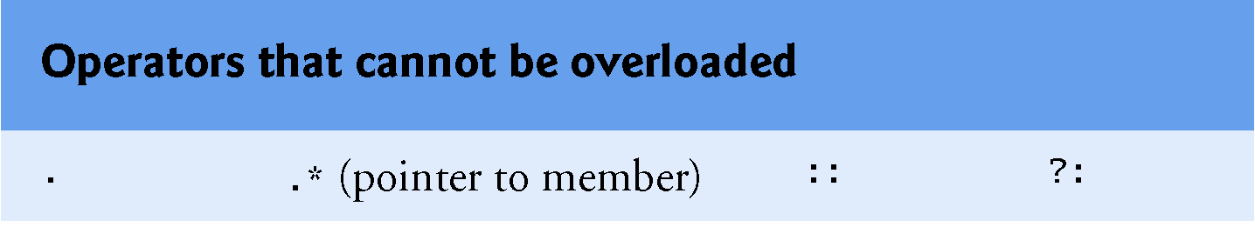
Figure 18.2 Operators That Cannot Be Overloaded

Slide 21
18.3 Fundamentals of Operator Overloading (5 of 7)
The precedence of an operator cannot be changed by overloading.
However, parentheses can be used to force the order of evaluation of overloaded operators in an expression.
The associativity of an operator cannot be changed by overloading
if an operator normally associates from left to right, then so do all of its overloaded versions.
You cannot change the “arity” of an operator (that is, the number of operands an operator takes)
overloaded unary operators remain unary operators; overloaded binary operators remain binary operators. Operators &, *, + and − all have both unary and binary versions; these unary and binary versions can be separately overloaded.

Slide 22
18.3 Fundamentals of Operator Overloading (6 of 7)
You cannot create new operators; only existing operators can be overloaded.
The meaning of how an operator works on values of fundamental types cannot be changed by operator overloading.
For example, you cannot make the + operator subtract two ints. Operator overloading works only with objects of user-defined types or with a mixture of an object of a user-defined type and an object of a fundamental type.

Slide 23
18.3 Fundamentals of Operator Overloading (7 of 7)
Related operators, like + and
must be overloaded separately.
When overloading
or any of the assignment operators, the operator overloading function must be declared as a class member.
For all other overloadable operators, the operator overloading functions can be member functions or non-member functions.

Slide 24
Software Engineering Observation 18.1
Overload operators for class types so they work as closely as possible to the way built-in operators work on fundamental types.

Slide 25
18.4 Overloading Binary Operators
A binary operator can be overloaded as a non-static member function with one parameter or as a non-member function with two parameters (one of those parameters must be either a class object or a reference to a class object).
As a non-member function, binary operator < must take two arguments—one of which must be an object (or a reference to an object) of the class.

Slide 26
18.5 Overloading the Binary Stream Insertion and Stream Extraction Operators (1 of 6)
You can input and output fundamental-type data using the stream extraction operator
and the stream insertion operator
The C++ class libraries overload these binary operators for each fundamental type, including pointers and char * strings.
You can also overload these operators to perform input and output for your own types.
The program of Figures 18.3 –18.5 overloads these operators to input and output PhoneNumber objects in the format “(000) 000-0000.” The program assumes telephone numbers are input correctly.

Slide 27
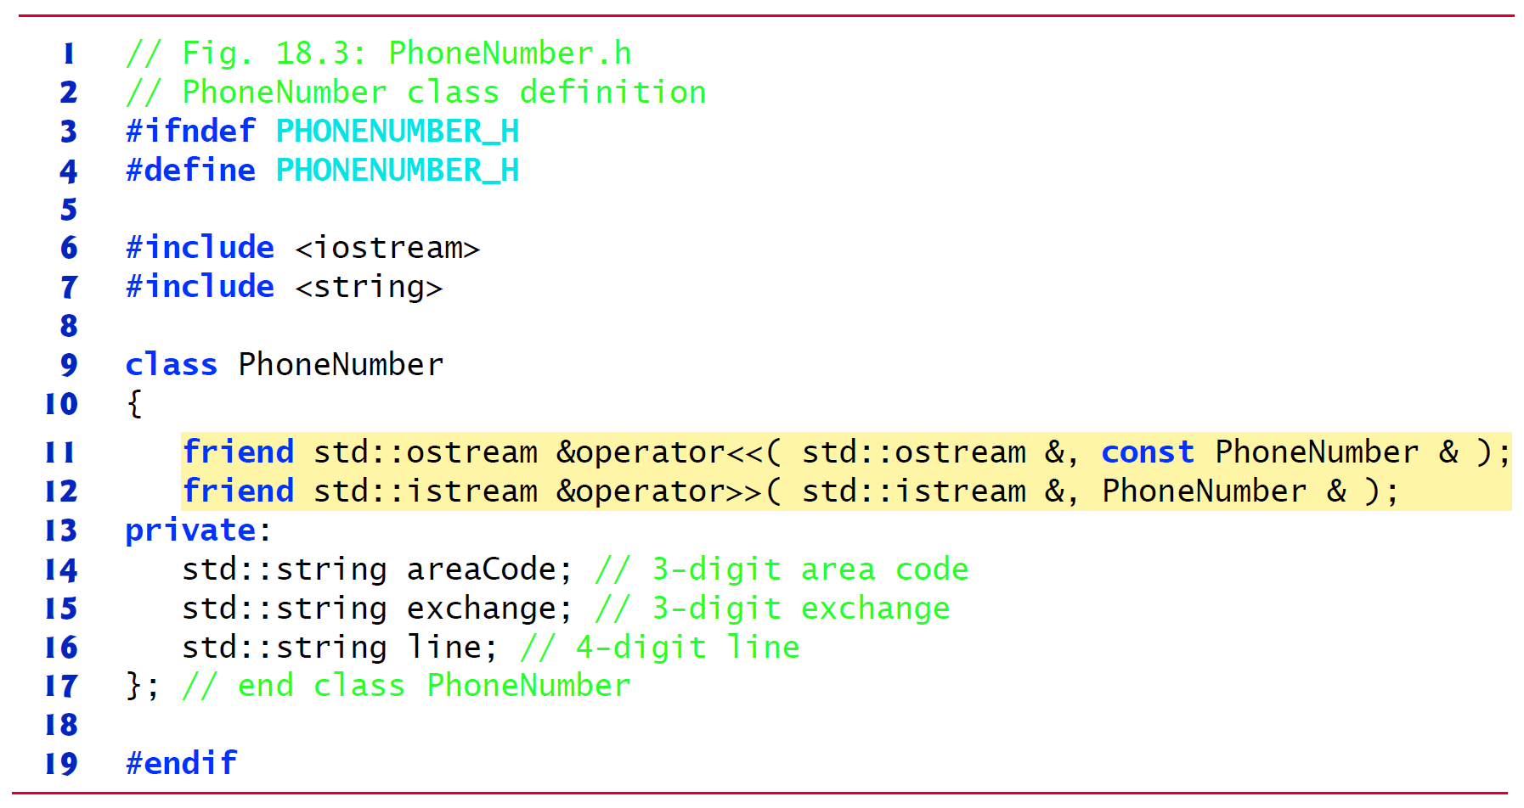
Figure 18.3 PhoneNumber Class with Overloaded Stream Insertion and Stream Extraction Operators as Friend Functions

Slide 28
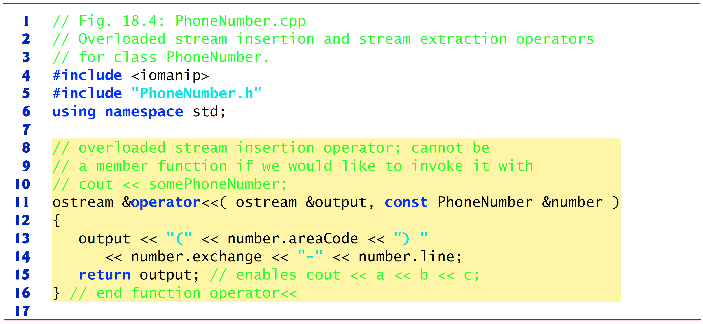
Figure 18.4 Overloaded Stream Insertion and Stream Extraction Operators for Class PhoneNumber (1 of 2)

Slide 29
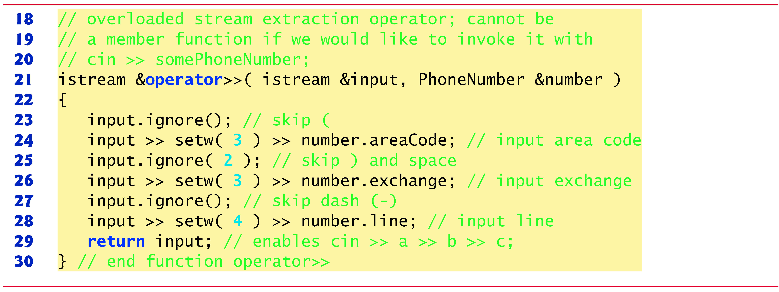
Figure 18.4 Overloaded Stream Insertion and Stream Extraction Operators for Class PhoneNumber (2 of 2)

Slide 30
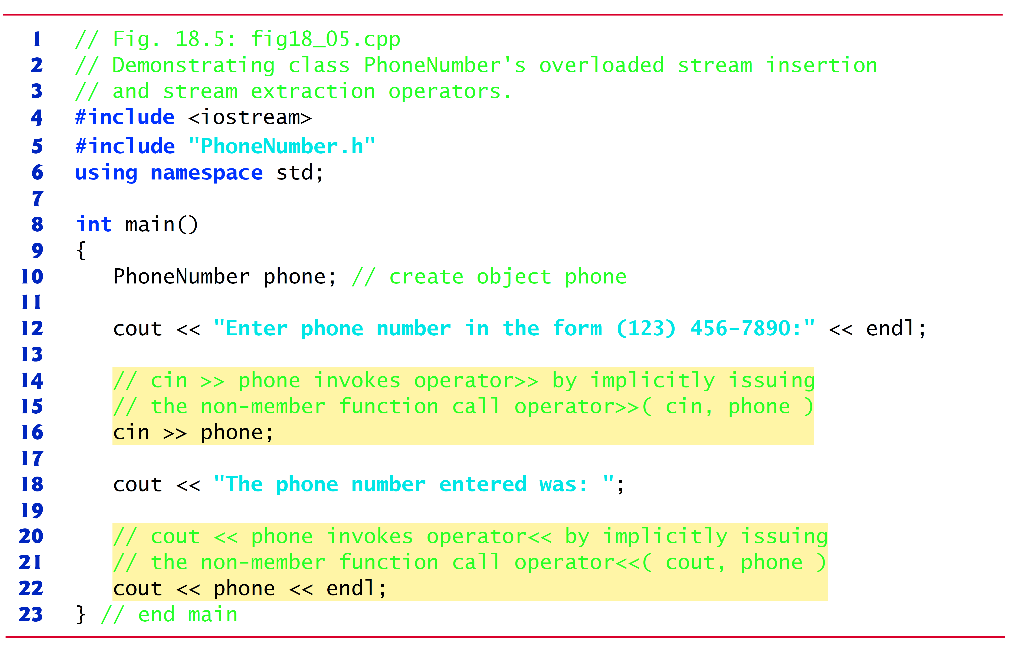
Figure 18.5 Overloaded Stream Insertion and Stream Extraction Operators (1 of 2)

Slide 31
Figure 18.5 Overloaded Stream Insertion and Stream Extraction Operators (2 of 2)

Slide 32


18.5 Overloading the Binary Stream Insertion and Stream Extraction Operators (2 of 6)
Overloading the Stream Extraction
(Figure 18.4 (see slide 29), lines 21–30) takes i stream reference input and Phone Number reference number as arguments and returns an i stream reference.
Operator function
The stream extraction operator function
inputs phone numbers of the form
(800) 555-1212
When the compiler sees the expression
In line 16 of Figure 18.5, the compiler generates the non-member function call
When this call executes, reference parameter input (Figure 18.4 (see slide 29), line 21) becomes an alias for cin and reference parameter number becomes an alias for phone.

Slide 33
18.5 Overloading the Binary Stream Insertion and Stream Extraction Operators (3 of 6)
The operator function reads as strings the three parts of the telephone number into the area Code (line 24), exchange (Line 26) and line (line 28) members of the Phone Number object referenced by parameter Number.
Stream manipulator set w limits the number of characters read into each string.
The parentheses, space and dash characters are skipped by calling i stream member function ignore (Figure 18.4 (see slide 29), lines 23, 25 and 27), which discards the specified number of characters in the input stream (one character by default).

Slide 34
18.5 Overloading Stream Insertion and Stream Extraction Operators (1 of 3)
Function
returns i stream reference input (i.e., c in).
This enables input operations on PhoneNumber objects to be cascaded with input operations on other PhoneNumber objects or on objects of other data types.

Slide 35
Good Programming Practice 18.1
Overloaded operators should mimic the functionality of their built-in counterparts—e.g., the + operator should perform addition, not subtraction. Avoid excessive or inconsistent use of operator overloading, as this can make a program cryptic and difficult to read.

Slide 36


18.5 Overloading Stream Insertion and Stream Extraction Operators
Overloading the Stream Insertion
The stream insertion operator function (Figure 18.4 (see slide 30), lines 11-16) takes an o stream reference (output) and a const Phone Number reference (number) as arguments and returns an o stream reference.
Function
displays objects of type PhoneNumber.
When the compiler sees the expression
in line 22 if Figure 18.5 (see slides 30-31), the compiler generates the non-member function call
Function
displays the parts of the telephone number as strings, because they’re stored as string objects.

Slide 37
18.5 Overloading the Binary Stream Insertion and Stream Extraction Operators (4 of 6)
Overloaded Operators as Non-Member friend Functions
The functions
are declared in PhoneNumber as non-member, friend functions.
They’re non-member functions because the object of class PhoneNumber is the operator’s right operand.

Slide 38
Software Engineering Observation 18.2
New input/output capabilities for user-defined types are added to C++ without modifying standard input/output library classes. This is another example of C++’s extensibility.

Slide 39
18.5 Overloading the Binary Stream Insertion and Stream Extraction Operators (5 of 6)
Why Overloaded Stream Insertion and Stream Extraction Operators Are Overloaded as Non-Member Functions
The overloaded stream insertion
is used in an expression in which the left operand has type o stream &, as in
To use the operator in this manner where the right operand is an object of a user-defined class, it must be overloaded as a non-member function.

Slide 40
18.5 Overloading the Binary Stream Insertion and Stream Extraction Operators (6 of 6)
Similarly, the overloaded stream extraction
is used in an expression in which the left operand has type i stream &, as in
and the right operand is an object of a user-defined class, so it, too, must be a non-member function.
Each of these overloaded operator functions may require access to the private data members of the class object being output or input, so these overloaded operator functions can be made friend functions of the class for performance reasons.

Slide 41
18.6 Overloading Unary Operators
A unary operator for a class can be overloaded as a non-static member function with no arguments or as a non-member function with one argument that must be an object (or a reference to an object) of the class.
A unary operator such as ! may be overloaded as a non-member function with one parameter.

Slide 42
18.7 Overloading the Unary Prefix and ++ and − − Operators Postfix (1 of 4)
The prefix and postfix versions of the increment and decrement operators can all be overloaded.
To overload the increment operator to allow both prefix and postfix increment usage, each overloaded operator function must have a distinct signature, so that the compiler will be able to determine which version of
is intended.
The prefix versions are overloaded exactly as any other prefix unary operator would be.

Slide 43




18.7 Overloading the Unary Prefix and ++ and − − Operators Postfix (2 of 4)
Suppose that we want to add 1 to the day in Date object d1.
When the compiler sees the preincrementing expression ++d1, the compiler generates the member-function call
The prototype for this operator function would be
If the prefix increment operator is implemented as a non-member function, then, when the compiler sees the expression ++d1, the compiler generates the function call
The prototype for this operator function would be declared in the Date class as

Slide 44


18.7 Overloading the Unary Prefix and ++ and − − Operators Postfix (3 of 4)
Overloading the Postfix Increment Operator
Overloading the postfix increment operator presents a challenge, because the compiler must be able to distinguish between the signatures of the overloaded prefix and postfix increment operator functions.
The convention that has been adopted in C++ is that, when the compiler sees the postincrementing expression d1++, it generates the member-function call
The prototype for this function is
The argument 0 is strictly a “dummy value” that enables the compiler to distinguish between the prefix and postfix increment operator functions.
The same syntax is used to differentiate between the prefix and postfix decrement operator functions.

Slide 45


18.7 Overloading the Unary Prefix and ++ and − − Operators Postfix (4 of 4)
If the postfix increment is implemented as a non-member function, then, when the compiler sees the expression d1++, the compiler generates the function call
The prototype for this function would be
Once again, the 0 argument is used by the compiler to distinguish between the prefix and postfix increment operators implemented as non-member functions.
The postfix increment operator returns Date objects by value, whereas the prefix increment operator returns Date objects by reference—the postfix increment operator typically returns a temporary object that contains the original value of the object before the increment occurred.

Slide 46
Performance Tip 18.1
The extra object that’s created by the postfix increment (or decrement) operator can result in a performance problem—especially when the operator is used in a loop. For this reason, you should prefer the overloaded prefix increment and decrement operators.

Slide 47
18.8 Case Study: A Date Class (1 of 6)
The program of Figures 18.6–18.8 demonstrates a Date class, which uses overloaded prefix and postfix increment operators to add 1 to the day in a Date object, while causing appropriate increments to the month and year if necessary.

Slide 48
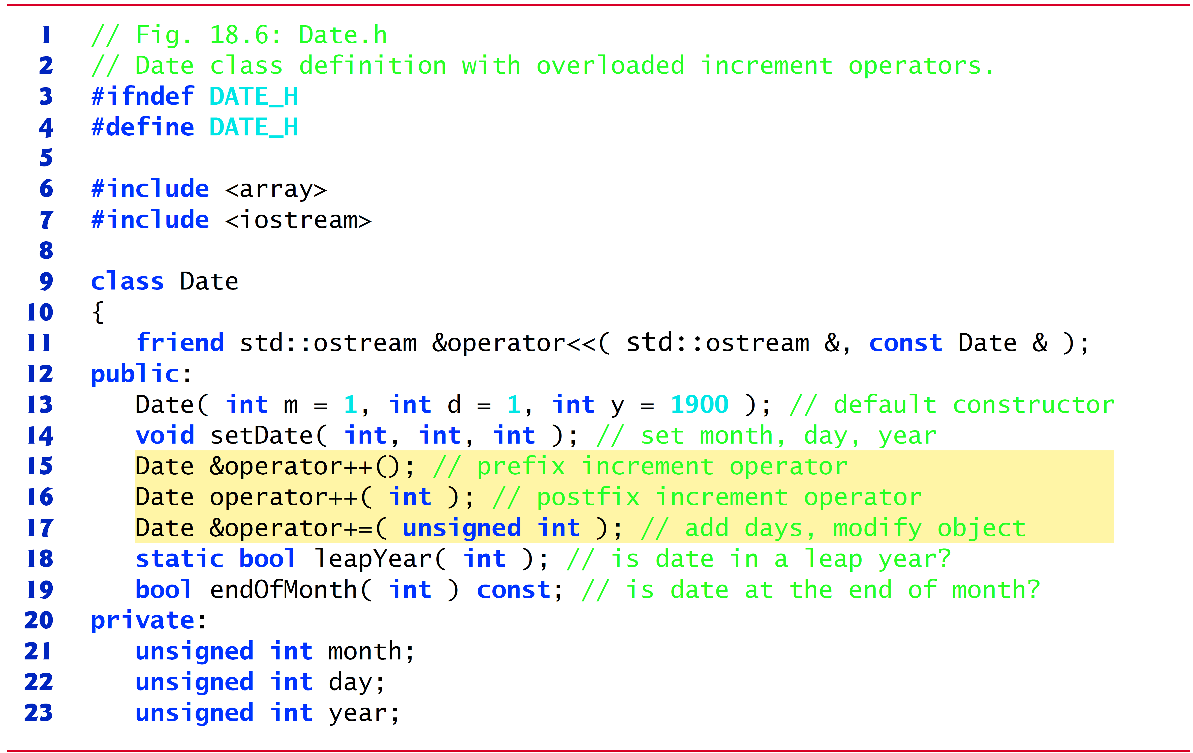
Figure 18.6 Date Class Definition with Overloaded Increment Operators (1 of 2)

Slide 49
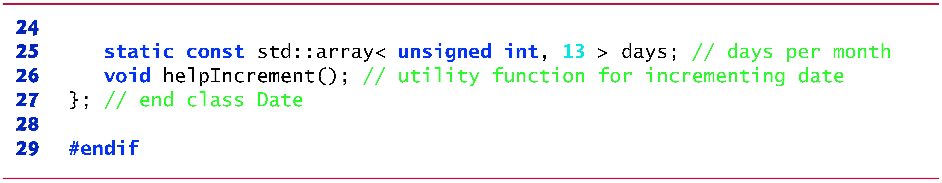
Figure 18.6 Date Class Definition with Overloaded Increment Operators (2 of 2)

Slide 50
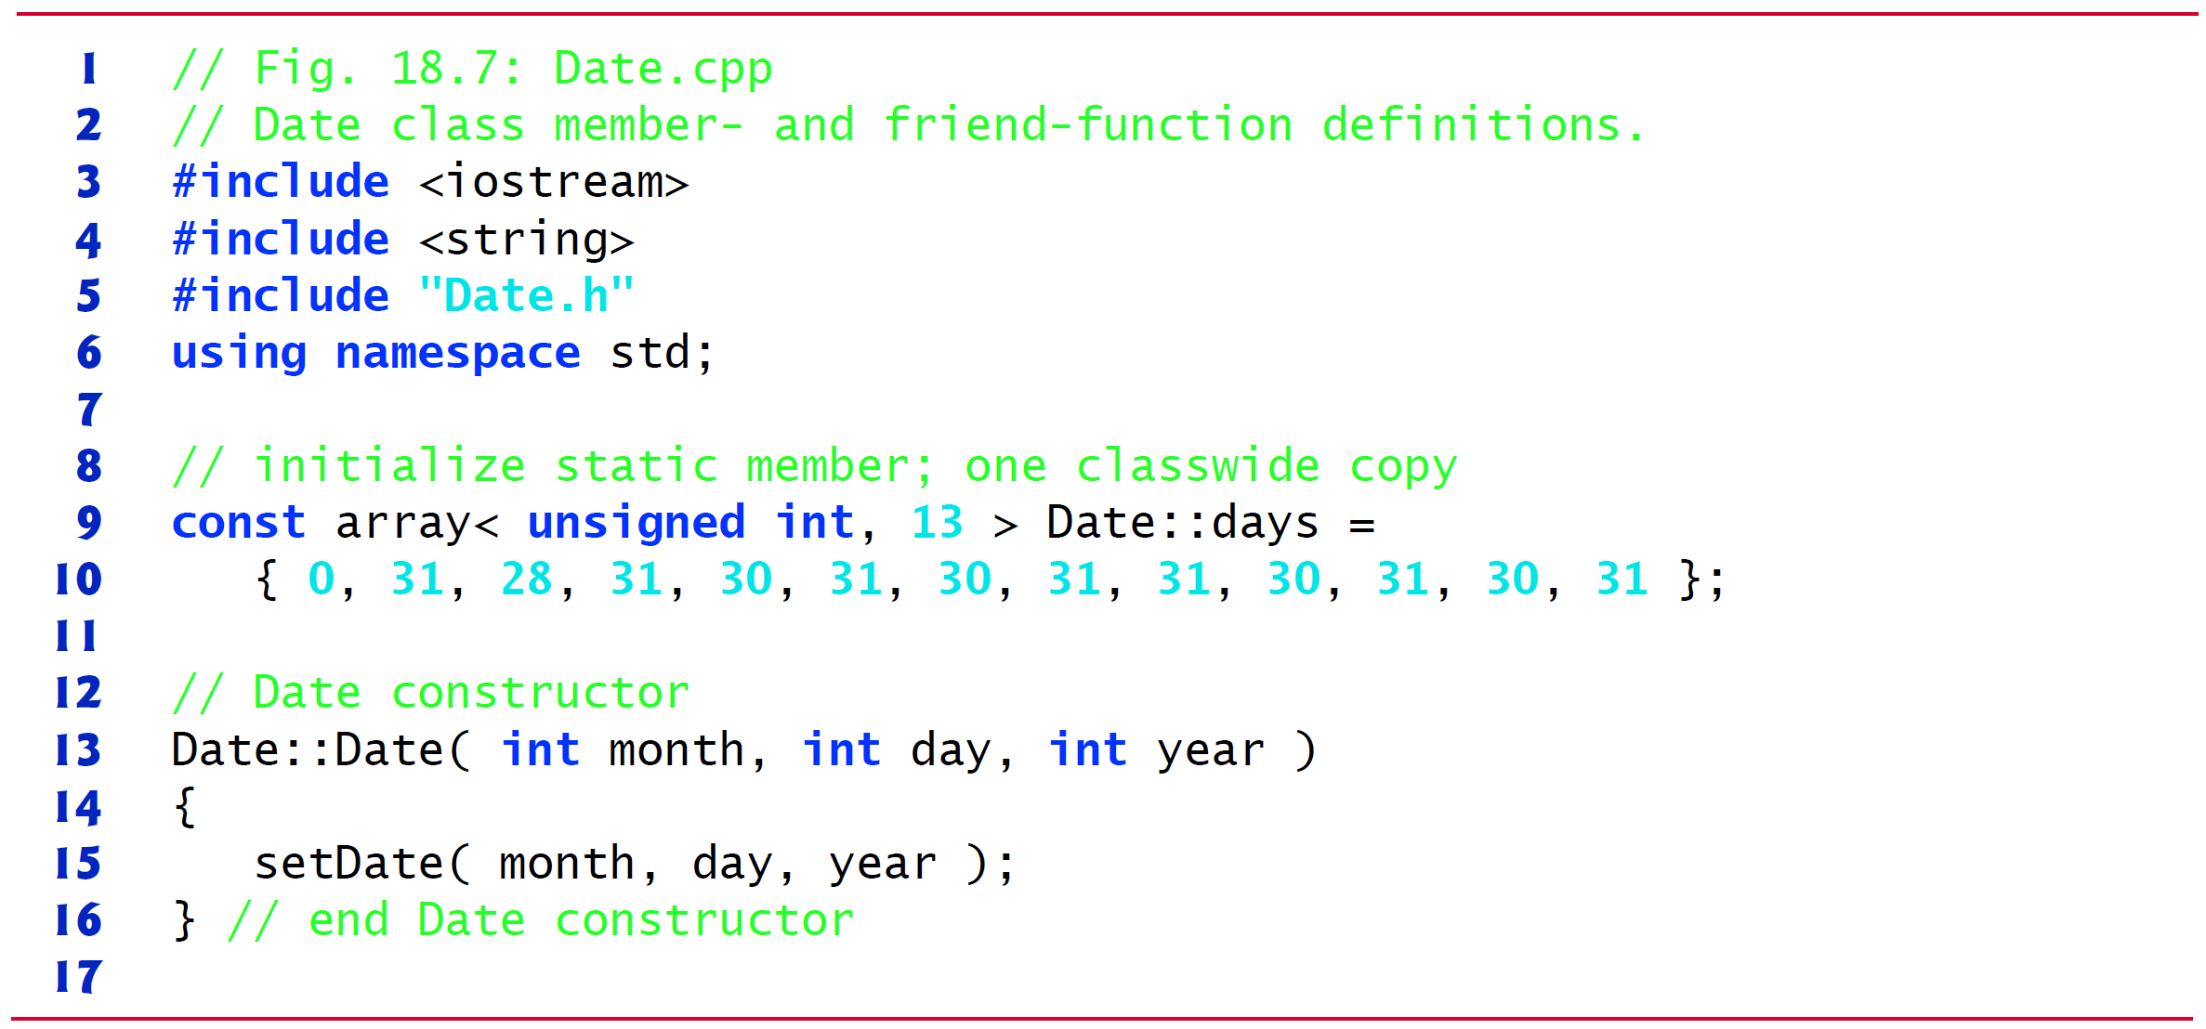
Figure 18.7 Date Class Member- and Friend-Function Definitions (1 of 6)

Slide 51
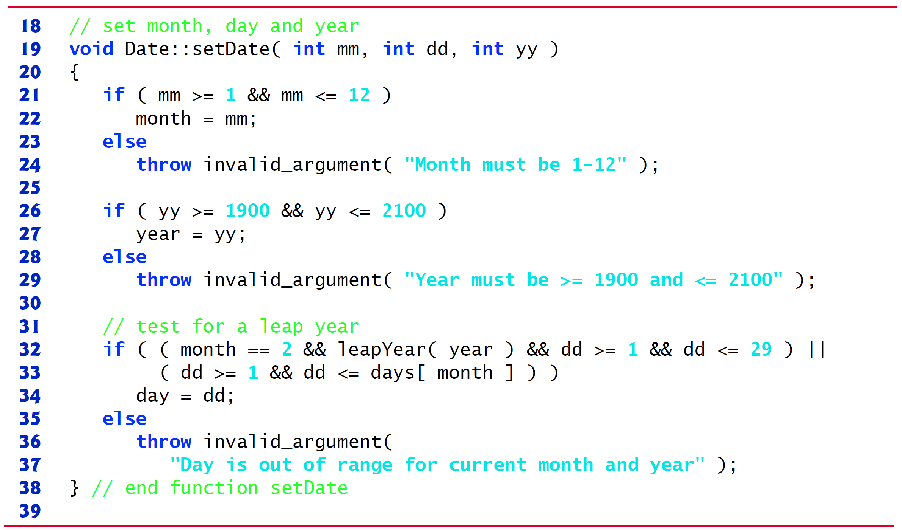
Figure 18.7 Date Class Member- and Friend-Function Definitions (2 of 6)

Slide 52
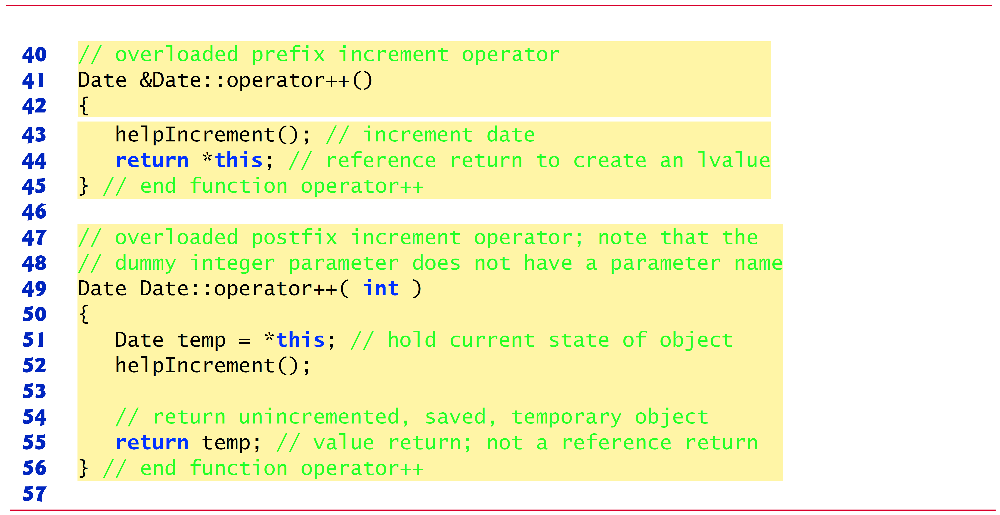
Figure 18.7 Date Class Member- and Friend-Function Definitions (3 of 6)

Slide 53
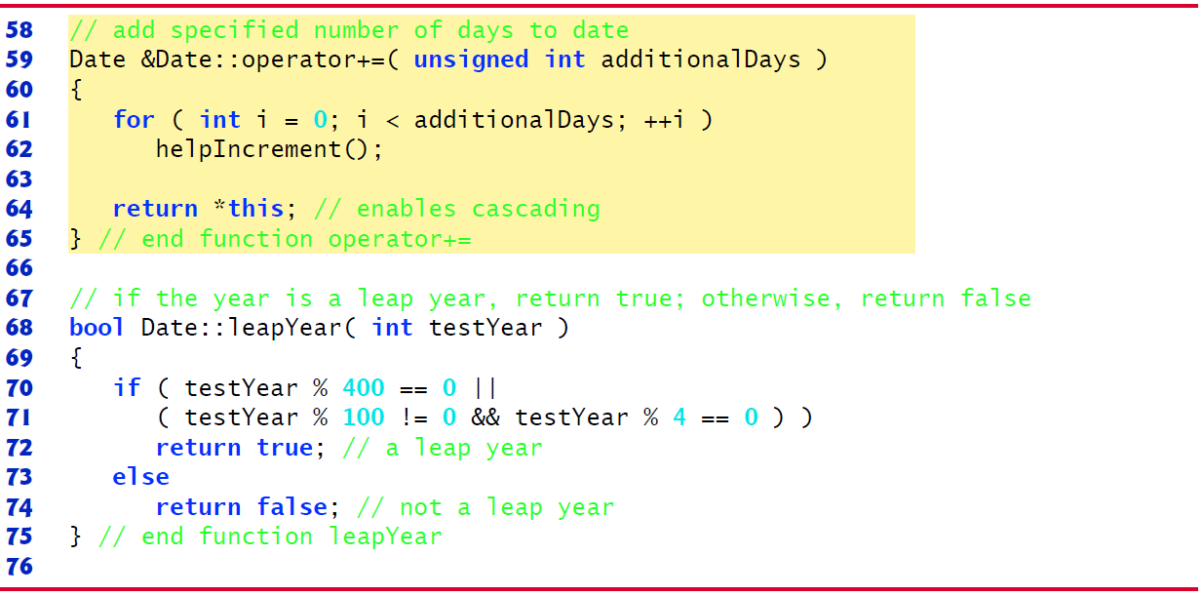
Figure 18.7 Date Class Member- and Friend-Function Definitions (4 of 6)

Slide 54
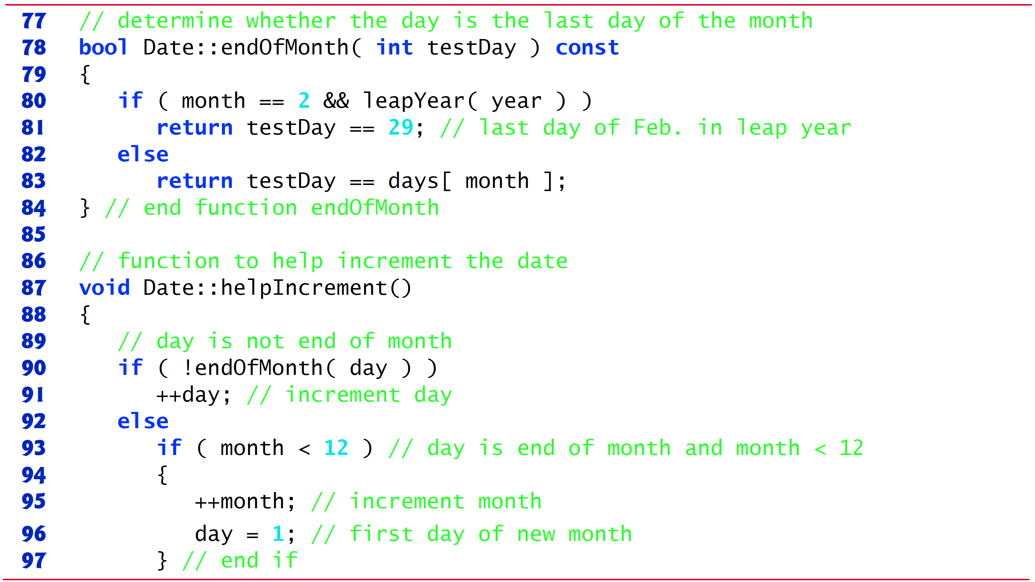
Figure 18.7 Date Class Member- and Friend-Function Definitions (5 of 6)

Slide 55
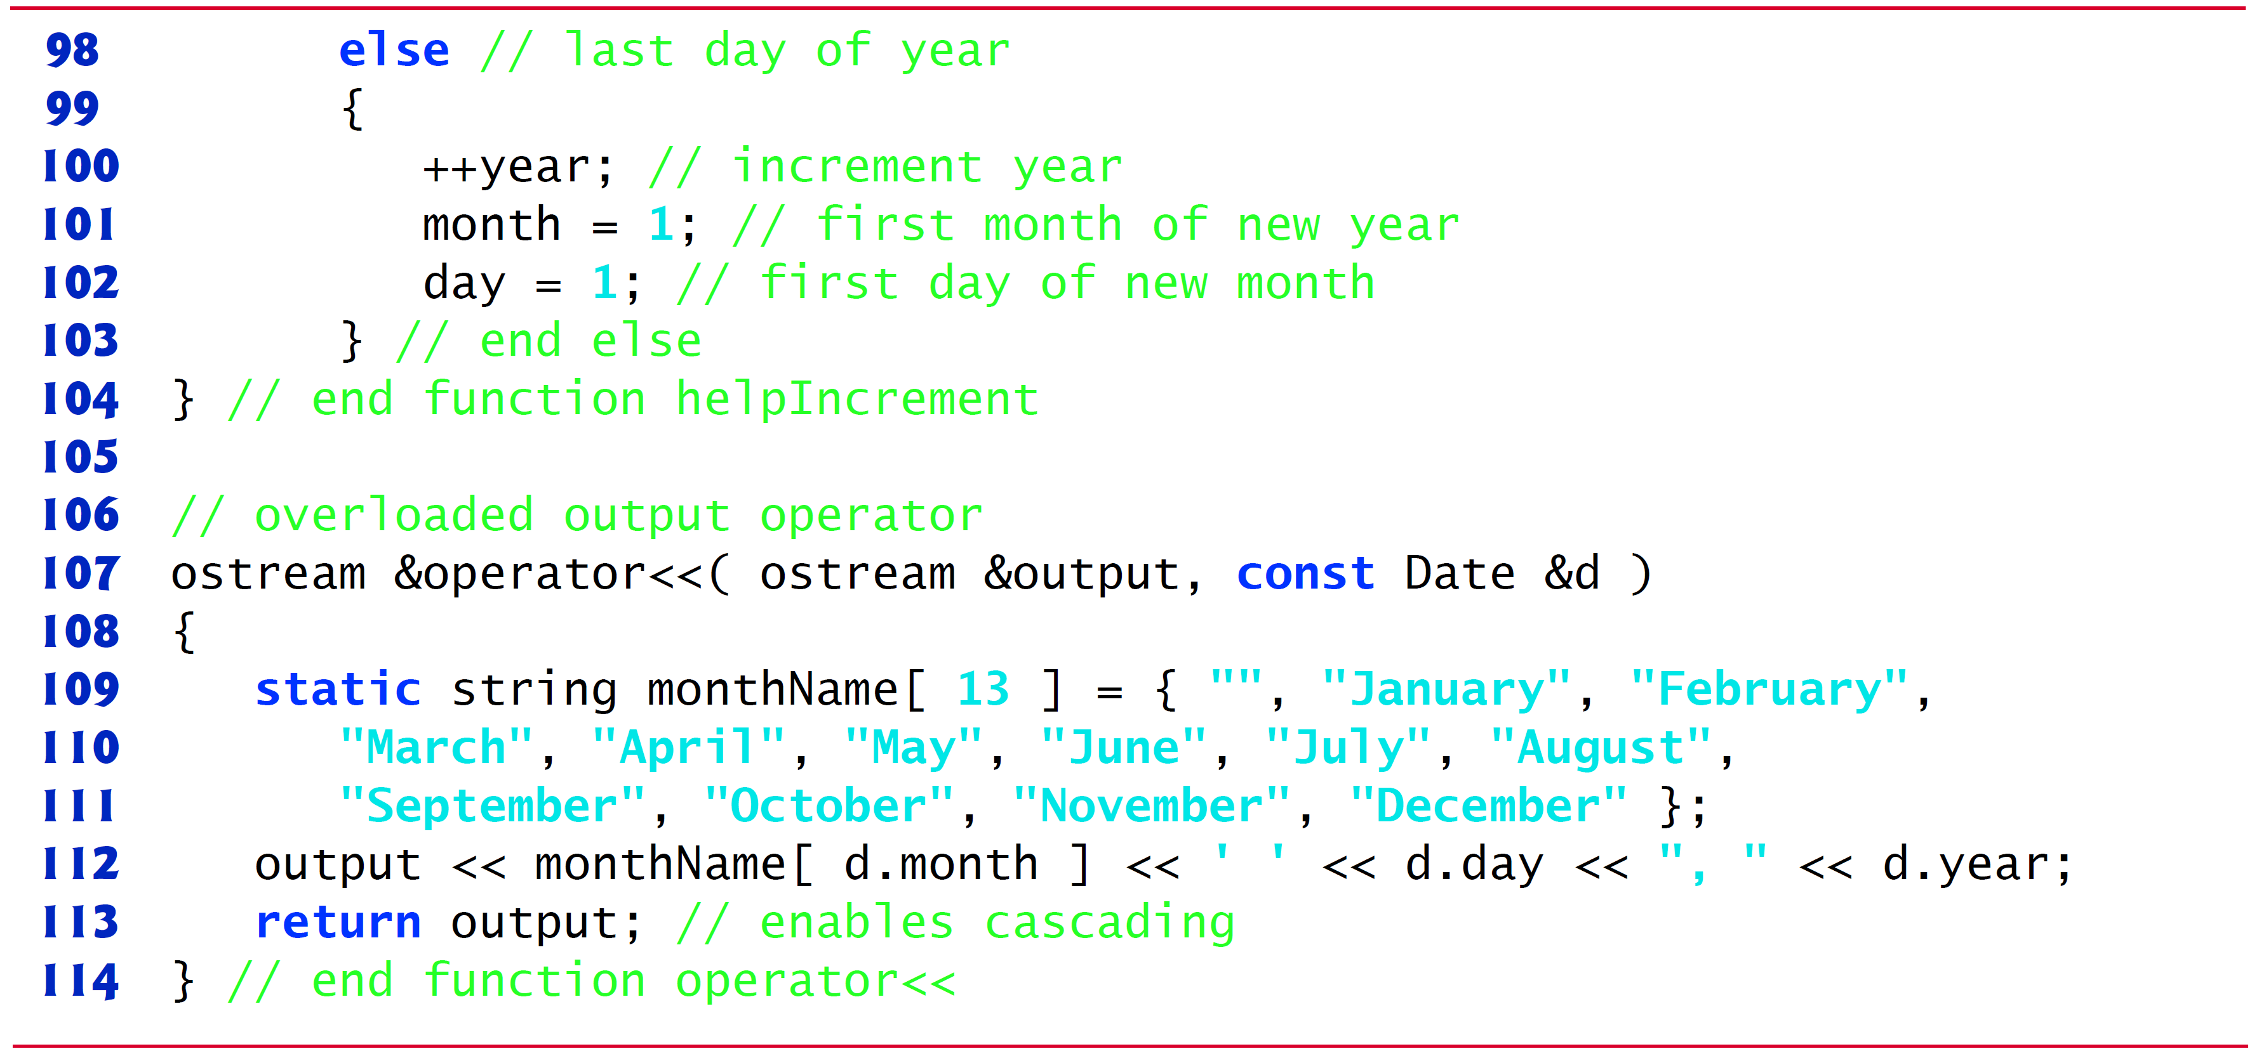
Figure 18.7 Date Class Member- and Friend-Function Definitions (6 of 6)

Slide 56
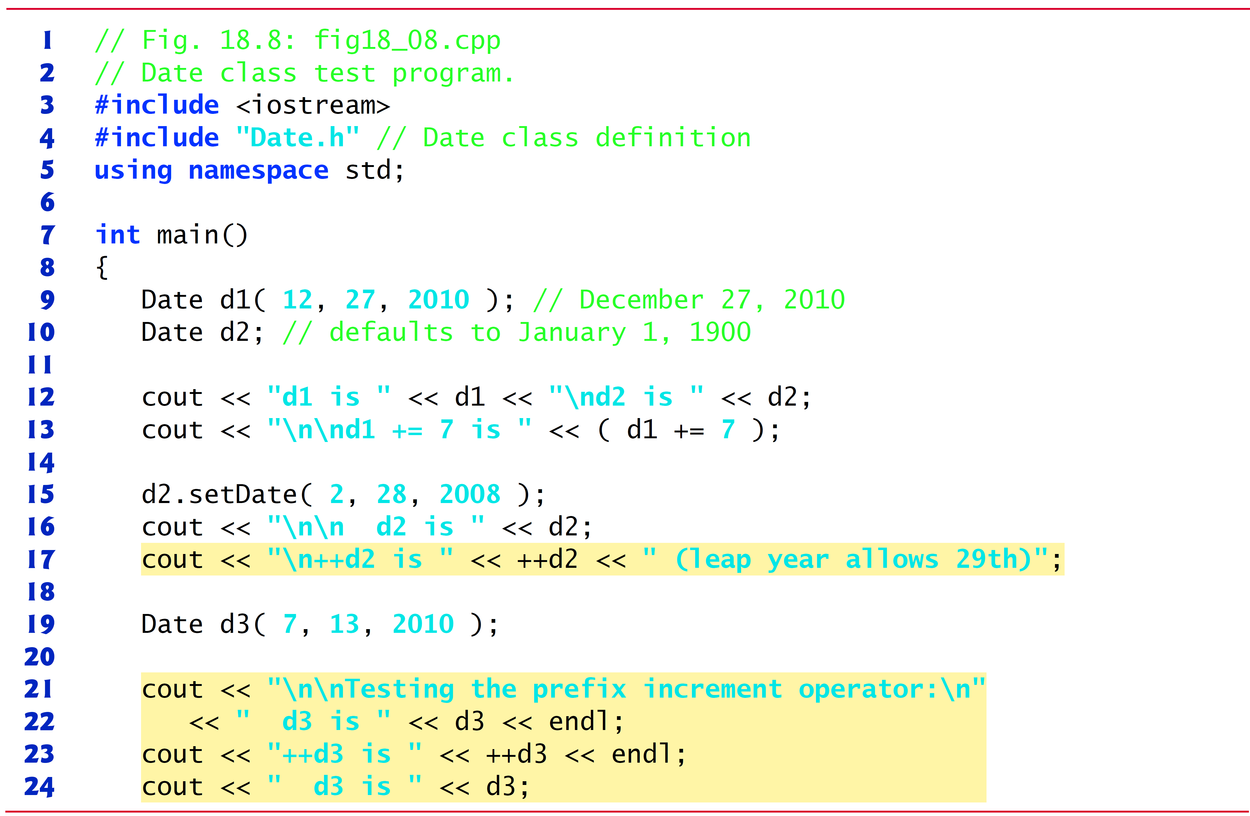
Figure 18.8 Date Class Test Program (1 of 2)

Slide 57
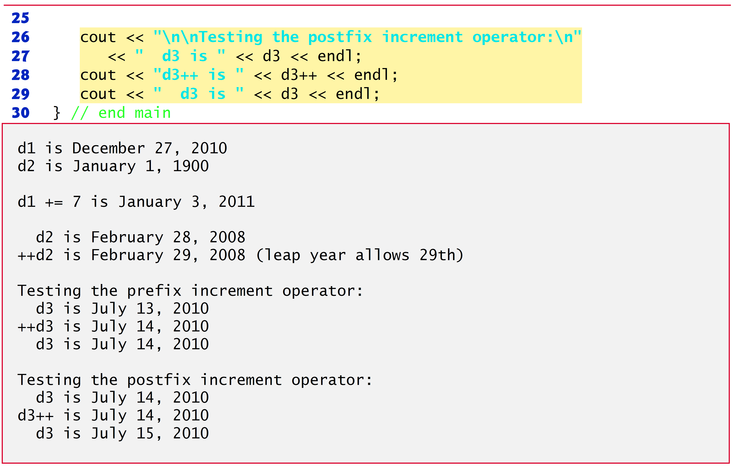
Figure 18.8 Date Class Test Program (2 of 2)

Slide 58
18.8 Case Study: A Date Class (2 of 6)
The Date constructor (defined in Figure 18.7 (see slide 50), lines 13–16) calls set Date to validate the month, day and year specified.
Invalid values for the month, day or year result in invalid_argument exceptions.

Slide 59
18.8 Case Study: A Date Class (3 of 6)
Date Class Prefix Increment Operator
Overloading the prefix increment operator is straightforward.
The prefix increment operator (defined in Figure 18.7 (see slide 50), lines 41–45) calls utility function helpIncrement (defined in Figure 18.7 (see slide 54-55), lines 87–104) to increment the date.
This function deals with “wraparounds” or “carries” that occur when we increment the last day of the month.
These carries require incrementing the month.
If the month is already 12, then the year must also be incremented and the month must be set to 1.
Function help Increment uses function end Of Month to determine whether the end of a month has been reached and increment the day correctly.

Slide 60
18.8 Case Study: A Date Class (4 of 6)
The overloaded prefix increment operator returns a reference to the current Date object (i.e., the one that was just incremented).
This occurs because the current object,
is returned as a Date &.
Enables a preincremented Date object to be used as an l value, which is how the built-in prefix increment operator works for fundamental types.

Slide 61
18.8 Case Study: A Date Class (5 of 6)
Date Class Postfix Increment Operator
Overloading the postfix increment operator (defined in Figure 18.7 (see slide 52), lines 49–56) is trickier.
To emulate the effect of the postincrement, we must return an unincremented copy of the Date object.
So we’d like our postfix increment operator to operate the same way on a Date object.

Slide 62
18.8 Case Study: A Date Class (6 of 6)
On entry to
we save the current object
in temp (line 51).
Next, we call help Increment to increment the current Date object.
Then, line 55 returns the un incremented copy of the object previously stored in temp.
This function cannot return a reference to the local Date object temp, because a local variable is destroyed when the function in which it’s declared exits.

Slide 63
Common Programming Error 18.1
Returning a reference (or a pointer) to a local variable is a common error for which most compilers will issue a warning.

Slide 64
18.9 Dynamic Memory Management (1 of 8)
You can control the allocation and deallocation of memory in a program for objects and for arrays of any built-in or user-defined type.
Known as dynamic memory management; performed with new and delete.
You can use the new operator to dynamically allocate (i.e., reserve) the exact amount of memory required to hold an object or built-in array at execution time.
The object or built-in array is created in the free store (also called the heap)—a region of memory assigned to each program for storing dynamically allocated objects.
Once memory is allocated in the free store, you can access it via the pointer that operator new returns.
You can return memory to the free store by using the delete operator to deallocate it.

Slide 65
18.9 Dynamic Memory Management (2 of 8)
Obtaining Dynamic Memory with new
The new operator allocates storage of the proper size for an object of type Time, calls the default constructor to initialize the object and returns a pointer to the type specified to the right of the new operator (i.e., a Time *).
If new is unable to find sufficient space in memory for the object, it indicates that an error occurred by “throwing an exception.”

Slide 66
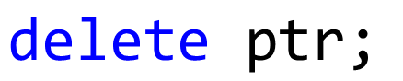
18.9 Dynamic Memory Management (3 of 8)
Releasing Dynamic Memory with delete
To destroy a dynamically allocated object, use the delete operator as follows:
This statement first calls the destructor for the object to which p t r points, then deallocates the memory associated with the object, returning the memory to the free store.

Slide 67
Common Programming Error 18.2
Not releasing dynamically allocated memory when it’s no longer needed can cause the system to run out of memory prematurely. This is sometimes called a “memory leak.”

Slide 68
Error-Prevention Tip 18.1
Do not delete memory that was not allocated by new. Doing so results in undefined behavior.

Slide 69
Error-Prevention Tip 18.2
After you delete a block of dynamically allocated memory be sure not to delete the same block again. One way to guard against this is to immediately set the pointer to nullptr. Deleting a nullptr has no effect.

Slide 70
18.9 Dynamic Memory Management (4 of 8)
Initializing Dynamic Memory
You can provide an initializer for a newly created fundamental-type variable, as in
The same syntax can be used to specify a comma-separated list of arguments to the constructor of an object.

Slide 71
18.9 Dynamic Memory Management (5 of 8)
Dynamically Allocating Built-In Arrays with new []
You can also use the new operator to allocate built-in arrays dynamically.
For example, a 10-element integer array can be allocated and assigned to gradesArray as follows:
The parentheses following new int[10] value initialize the array’s elements—fundamental numeric types are set to 0, bools are set to false, pointers are set to nullptr and class objects are initialized by their default constructors.
A dynamically allocated array’s size can be specified using any non-negative integral expression that can be evaluated at execution time.

Slide 72
18.9 Dynamic Memory Management (6 of 8)
C++11: Using a List Initializer with a Dynamically Allocated Built-In Array
Prior to C++11, when allocating a built-in array of objects dynamically, you could not pass arguments to each object’s constructor—each object was initialized by its default constructor. In C++11, you can use a list initializer to initialize the elements of a dynamically allocated built-in array, as in
The empty set of braces as shown here indicates that default initialization should be used for each element—for fundamental types each element is set to 0.
The braces may also contain a comma-separated list of initializers for the array’s elements.

Slide 73
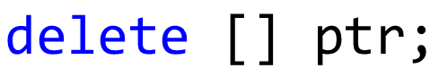
18.9 Dynamic Memory Management (7 of 8)
Releasing Dynamically Allocated Built-In Arrays with delete []
To deallocate a dynamically allocated array, use the statement
If the pointer points to a built-in array of objects, the statement first calls the destructor for every object in the array, then deallocates the memory.
Using delete or [] on a nullptr has no effect.

Slide 74
Common Programming Error 18.3
Using delete instead of delete [] for built-in arrays of objects can lead to runtime logic errors. To ensure that every object in the array receives a destructor call, always delete memory allocated as an array with operator delete []. Similarly, always delete memory allocated as an individual element with operator delete—the result of deleting a single object with operator delete [] is undefined.

Slide 75
18.9 Dynamic Memory Management (8 of 8)
C++11: Managing Dynamically Allocated Memory with unique_ptr
C++11’s new unique_ptr is a “smart pointer” for managing dynamically allocated memory.
When a unique_ptr goes out of scope, its destructor automatically returns the managed memory to the free store.

Slide 76
18.10 Case Study: Array Class (1 of 26)
Pointer-based arrays have many problems, including:
A program can easily “walk off” either end of a built-in array, because C++ does not check whether subscripts fall outside the range of the array.
Built-in arrays of size n must number their elements
alternate subscript ranges- are not allowed.
An entire built-in array cannot be input or output at once.
Two built-in arrays cannot be meaningfully compared with equality or relational operators.
When an array is passed to a general-purpose function designed to handle arrays of any size, the array’s size must be passed as an additional argument.
One built-in array cannot be assigned to another with the assignment operator.

Slide 77
18.10 Case Study: Array Class (2 of 26)
With C++, you can implement more robust array capabilities via classes and operator overloading as has been done with class templates array and vector in the C++ Standard Library.
In this section, we’ll develop our own custom array class that’s preferable to built-in arrays.
In this example, we create a powerful Array class:
Performs range checking.
Allows one Array object to be assigned to another with the assignment operator.

Slide 78
18.10 Case Study: Array Class (3 of 26)
Objects know their own size.
Input or output entire arrays with the stream extraction and stream insertion operators, respectively.
Can compare Arrays with the equality operators
C++ Standard Library class template vector provides many of these capabilities as well.

Slide 79
Figure 18.9 Array Class Test Program (1 of 7)

Slide 80
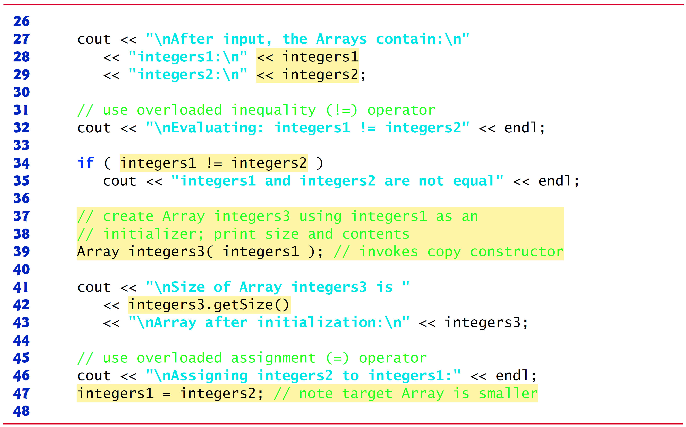
Figure 18.9 Array Class Test Program (2 of 7)

Slide 81
Figure 18.9 Array Class Test Program (3 of 7)

Slide 82
Figure 18.9 Array Class Test Program (4 of 7)

Slide 83
Figure 18.9 Array Class Test Program (5 of 7)

Slide 84
Figure 18.9 Array Class Test Program (6 of 7)

Slide 85
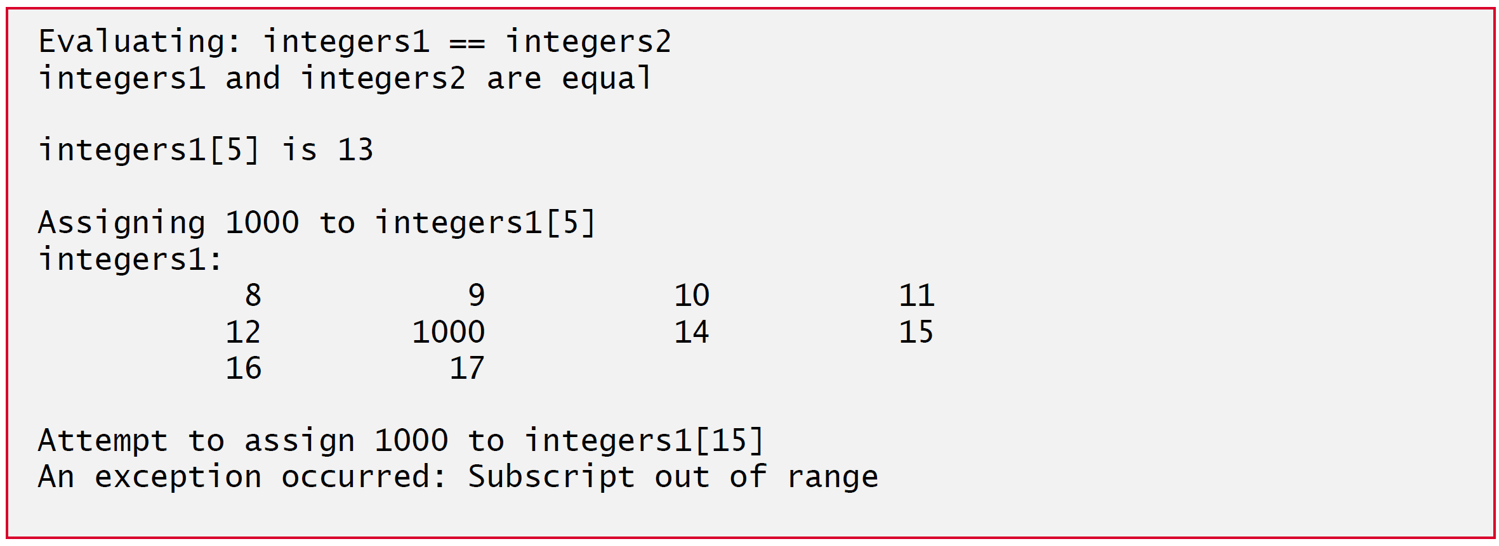
Figure 18.9 Array Class Test Program (7 of 7)

Slide 86
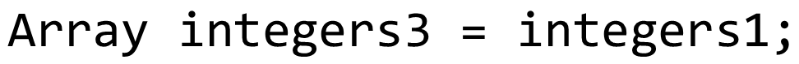
18.10 Case Study: Array Class (4 of 26)
The Array copy constructor copies the elements of one Array into another.
The copy constructor can also be invoked by writing line 39 as follows:
The equal sign in the preceding statement is not the assignment operator.
When an equal sign appears in the declaration of an object, it invokes a constructor for that object.
This form can be used to pass only a single argument to a constructor.

Slide 87
18.10 Case Study: Array Class (5 of 26)
The array subscript operator [] is not restricted for use only with arrays; it also can be used, for example, to select elements from other kinds of container classes, such as strings and dictionaries.
Also, when operator[] functions are defined, subscripts no longer have to be integers—characters, strings, floats or even objects of user-defined classes also could be used.

Slide 88

18.10 Case Study: Array Class (6 of 26)
Each Array object consists of a size member indicating the number of elements in the Array and an int pointer—ptr—that points to the dynamically allocated pointer-based array of integers managed by the Array object.
When the compiler sees an expression like
it invokes non-member function
with the call

Slide 89

18.10 Case Study: Array Class (7 of 26)
When the compiler sees an expression like
it invokes non-member function
with the call
These stream insertion and stream extraction operator functions cannot be members of class Array, because the Array object is always mentioned on the right side of the stream insertion operator and the stream extraction operator.

Slide 90
18.10 Case Study: Array Class (8 of 26)
You might be tempted to replace the counter-controlled for statement in lines 104–105 and many of the other for statements in class Array’s implementation with the C++11 range-based for statement.
Unfortunately, range-based for does not work with dynamically allocated built-in arrays.

Slide 91
Figure 18.10 Array Class Definition with Overloaded Operators (1 of 2)

Slide 92
Figure 18.10 Array Class Definition with Overloaded Operators (2 of 2)

Slide 93
Figure 18.11 Array Class Member- and Friend-Function Definitions (1 of 6)

Slide 94
Figure 18.11 Array Class Member- and Friend-Function Definitions (2 of 6)

Slide 95
Figure 18.11 Array Class Member- and Friend-Function Definitions (3 of 6)

Slide 96
Figure 18.11 Array Class Member- and Friend-Function Definitions (4 of 6)

Slide 97
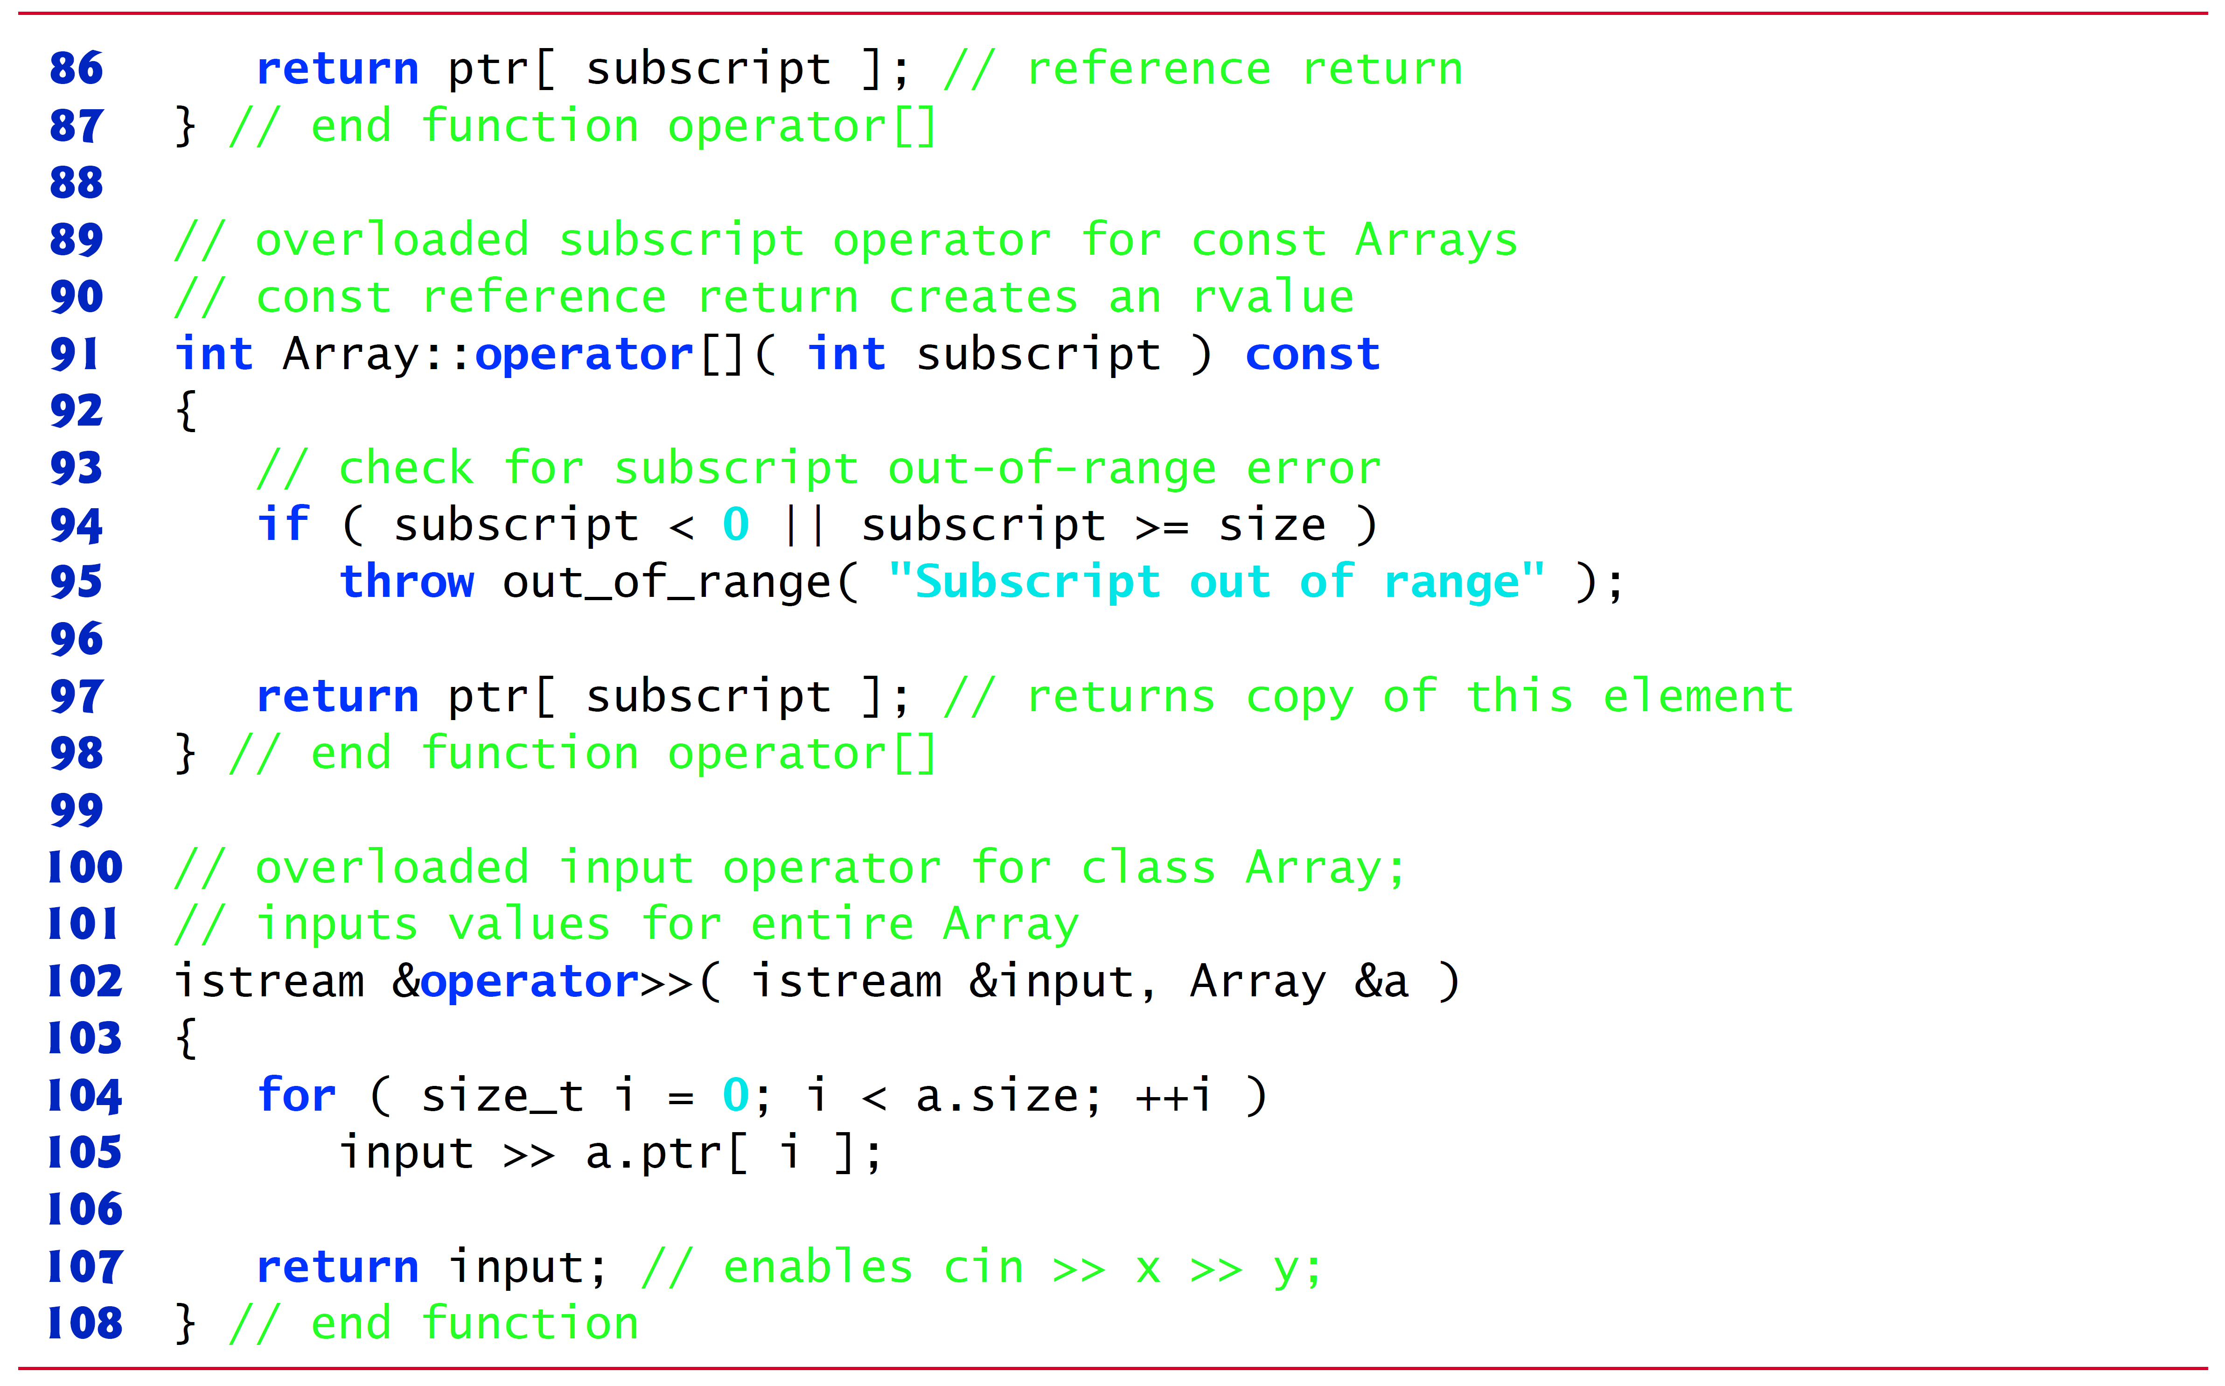
Figure 18.11 Array Class Member- and Friend-Function Definitions (5 of 6)

Slide 98
Figure 18.11 Array Class Member- and Friend-Function Definitions (6 of 6)

Slide 99
18.10 Case Study: Array Class (9 of 26)
Array Default Constructor
Line 14 of Figure 18.10 (see slide 91) declares the default constructor for the class and specifies a default size of 10 elements.
The default constructor (defined in Figure 18.11 (see slide 93), lines 11–18) validates and assigns the argument to data member size, uses new to obtain the memory for the internal pointer-based representation of this Array and assigns the pointer returned by new to data member ptr.
Then the constructor uses a for statement to set all the elements of the array to zero.

Slide 100
18.10 Case Study: Array Class (10 of 26)
Array Copy Constructor
Line 15 of Figure 18.10 (see slide 91) declares a copy constructor (defined in Figure 18.11 (see slides 93-94), lines 22–28) that initializes an Array by making a copy of an existing Array object.
Such copying must be done carefully to avoid the pitfall of leaving both Array objects pointing to the same dynamically allocated memory.
This is exactly the problem that would occur with default memberwise copying, if the compiler is allowed to define a default copy constructor for this class.
Copy constructors are invoked whenever a copy of an object is needed, such as in passing an object by value to a function, returning an object by value from a function or initializing an object with a copy of another object of the same class.

Slide 101
18.10 Case Study: Array Class (11 of 26)
The copy constructor for Array copies the size of the initializer Array into data member size, uses new to obtain the memory for the internal pointer-based representation of this Array and assigns the pointer returned by new to data member ptr.
Then the copy constructor uses a for statement to copy all the elements of the initializer Array into the new Array object.
An object of a class can look at the private data of any other object of that class (using a handle that indicates which object to access).

Slide 102
Software Engineering Observation 18.3
The argument to a copy constructor should be a const reference to allow a const object to be copied.

Slide 103
Common Programming Error 18.4
If the copy constructor simply copied the pointer in the source object to the target object’s pointer, then both would point to the same dynamically allocated memory. The first destructor to execute would delete the dynamically allocated memory, and the other object’s ptr would point to memory that’s no longer allocated, a situation called a dangling pointer—this would likely result in a serious runtime error (such as early program termination) when the pointer was used.

Slide 104
18.10 Case Study: Array Class (12 of 26)
Array Destructor
Line 16 of Figure 18.10 (see slide 91) declares the class’s destructor (defined in Figure 18.11 (see slide 94), lines 31–34).
The destructor is invoked when an object of class Array goes out of scope.
The destructor uses delete [] to release the memory allocated dynamically by new in the constructor.

Slide 105
Error-Prevention Tip 18.3
If after deleting dynamically allocated memory, the pointer will continue to exist in memory, set the pointer’s value to nullptr to indicate that the pointer no longer points to memory in the free store. By setting the pointer to nullptr, the program loses access to that freestore space, which could be reallocated for a different purpose. If you do not set the pointer to nullptr, your code could inadvertently access the reallocated memory, causing subtle, nonrepeatable logic errors. We did not set ptr to nullptr in line 33 of Figure 18.11 (see slide 94) because after the destructor executes, the Array object no longer exists in memory.

Slide 106

18.10 Case Study: Array Class (13 of 26)
Overloaded Assignment Operator
Line 19 of Figure 18.10 (see slide 91) declares the overloaded assignment operator function for the class.
When the compiler sees the expression integers1 = integers2 in line 47 of Figure 18.9 (see slide 80), the compiler invokes member function operator= with the call
Member function operator=’s implementation (Figure 18.11 (see slides 95), lines 44–62) tests for self-assignment (line 46) in which an Array object is being assigned to itself.
When this is equal to the right operand’s address, a self-assignment is being attempted, so the assignment is skipped.

Slide 107
18.10 Case Study: Array Class (14 of 26)
operator= determines whether the sizes of the two Arrays are identical (line 50); in that case, the original array of integers in the left-side Array object is not reallocated.
Otherwise, operator= uses delete [] (line 52) to release the memory, copies the size of the source array to the size of the target Array (line 53), uses new to allocate memory for the target Array and places the pointer returned by new into the Array’s ptr member.
Regardless of whether this is a self-assignment, the member function returns the current object
as a constant reference; this enables cascaded Array assignments such as x = y = z, but prevents ones like (x = y) = z because z cannot be assigned to the const Array- reference that is returned by (x = y).

Slide 108
Software Engineering Observation 18.4
A copy constructor, a destructor and an overloaded assignment operator are usually provided as a group for any class that uses dynamically allocated memory. With the addition of move semantics in C++11, other functions should also be provided, as we discuss in Chapter 24.

Slide 109
Common Programming Error 18.5
Not providing a copy constructor and overloaded assignment operator for a class when objects of that class contain pointers to dynamically allocated memory is a potential logic error.

Slide 110
18.10 Case Study: Array Class (15 of 26)
C++11: Deleting Unwanted Member Functions from Your Class
Prior to C++11, you could prevent class objects from being copied or assigned by declaring as private the class’s copy constructor and overloaded assignment operator.
As of C++11, you can simply delete these functions from your class.
To do so in class Array, replace the prototypes in lines 15 and 19 of Figure 18.10 (see slide 91) with:

Slide 111
18.10 Case Study: Array Class (16 of 26)
Though you can delete any member function, it’s most commonly used with member functions that the compiler can auto-generate—the default constructor, copy constructor, assignment operator, and in C++ 11, the move constructor and move assignment operator.

Slide 112

18.10 Case Study: Array Class (17 of 26)
Overloaded Equality and Inequality Operators
Line 20 of Figure 18.10 (see slide 91) declares the overloaded equality operator
for the class.
When the compiler sees the expression integers1
integers2 in line 55 of Figure 18.9 (see slide 81), the compiler invokes member function operator
with the call

Slide 113
18.10 Case Study: Array Class (18 of 26)
Member function operator
(defined in Figure 18.11 (see slide 96), lines 66–76) immediately returns false if the size members of the Arrays are not equal.
Otherwise, operator
compares each pair of elements.
If they’re all equal, the function returns true.
The first pair of elements to differ causes the function to return false immediately.

Slide 114
18.10 Case Study: Array Class (19 of 26)
Lines 23–26 Figure 18.9 (see slides 79-80) define the overloaded inequality operator
Member function operator
uses the overloaded operator
function to deter-mine whether one Array is equal to another, then returns the opposite of that result.
Writing operator
in this manner enables you to reuse operator
which reduces the amount of code that must be written in the class.
Also, the full function definition for operator
is in the Array header.
Allows the compiler to inline the definition.

Slide 115

18.10 Case Study: Array Class (20 of 26)
Overloaded Subscript Operators
Lines 29 and 32 of Figure 18.10 (see slide 92) declare two overloaded subscript operators (defined in Figure 18.11 (see slides 96-97) in lines 80–87 and 91–98).
When the compiler sees the expression integers1[5] (Figure 18.9 (see slides 81), line 59), it invokes the appropriate overloaded operator[] member function by generating the call
The compiler creates a call to the const version of operator[] (Figure 18.11 (see slide 97), lines 91–98) when the subscript operator is used on a const Array object.

Slide 116
18.10 Case Study: Array Class (21 of 26)
Each definition of operator[] determines whether the subscript it receives as an argument is in range.
If it isn’t, each function prints an error message and terminates the program with a call to function exit.
If the subscript is in range, the non-const version of operator[] returns the appropriate Array element as a reference so that it may be used as a modifiable l value.
If the subscript is in range, the const version of operator[] returns a copy of the appropriate element of the Array.

Slide 117
18.10 Case Study: Array Class (22 of 26)
C++11: Managing Dynamically Allocated Memory with unique_ptr
In this case study, class Array’s destructor used delete [] to return the dynamically allocated built-in array to the free store.
As you recall, C++11 enables you to use unique_ptr to ensure that this dynamically allocated memory is deleted when the Array object goes out of scope.

Slide 118
18.10 Case Study: Array Class (23 of 26)
C++11: Passing a List Initializer to a Constructor
In Figure 7.4, we showed how to initialize an array object with a comma-separated list of initializers in braces, as in
C++11 now allows any object to be initialized with a list initializer and that the preceding statement can also be written without the =, as in

Slide 119
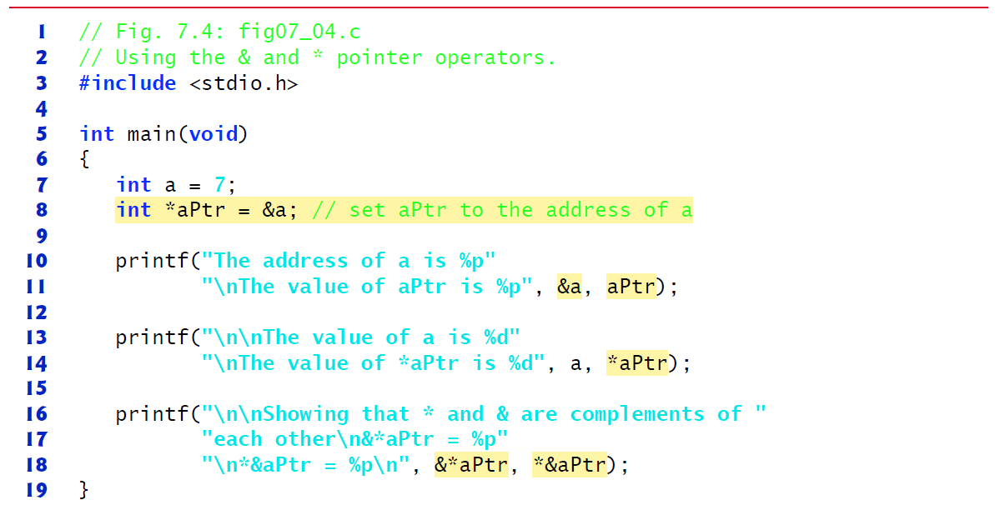
Figure 7.4 Using the & and * Pointer Operators (1 of 2)

Slide 120
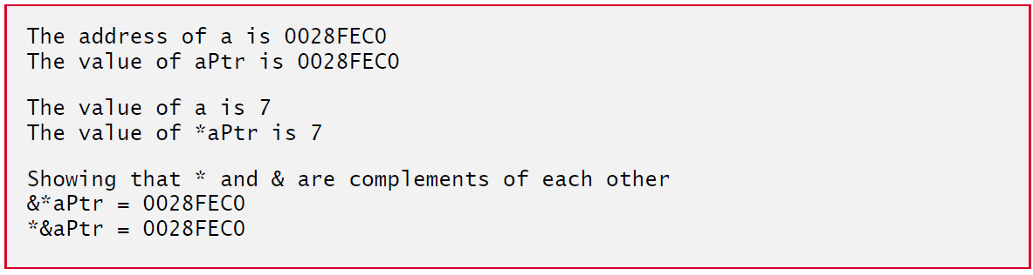
Figure 7.4 Using the & and * Pointer Operators (2 of 2)

Slide 121

18.10 Case Study: Array Class (24 of 26)
C++11 also allows you to use list initializers when you declare objects of your own classes.
For example, you can now provide an Array constructor that would enabled the following declarations:
or
each of which creates an Array object with five elements containing the integers from 1 to 5.

Slide 122
18.10 Case Study: Array Class (25 of 26)
To support list initialization, you can define a constructor that receives an object of the class template initializer_list. For class Array, you’d include the <initializer_list> header.
Then, you’d define a constructor with the first line:
You can determine the number of elements in the list parameter by calling its size member function.

Slide 123
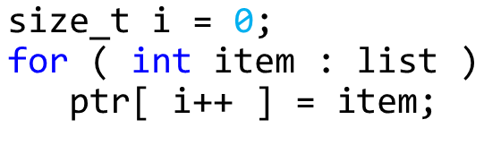
18.10 Case Study: Array Class (26 of 26)
To obtain each initializer and copy it into the Array object’s dynamically allocated built-in array, you can use a range-based for as follows:

Slide 124
18.11 Operators as Member versus. Non-Member Functions (1 of 2)
Whether an operator function is implemented as a member function or as a non-member function, the operator is still used the same way in expressions.
When an operator function is implemented as a member function, the leftmost (or only) operand must be an object (or a reference to an object) of the operator’s class.
If the left operand must be an object of a different class or a fundamental type, this operator function must be implemented as a non-member function (as we did in Section 18.5 when overloading
as the stream insertion and extraction operators, respectively).
A non-member operator function can be made a friend of a class if that function must access private or protected members of that class directly.
Operator member functions of a specific class are called only when the left operand of a binary operator is specifically an object of that class, or when the single operand of a unary operator is an object of that class.

Slide 125
18.11 Operators as Member versus. Non-Member Functions (2 of 2)
You might choose a non-member function to overload an operator to enable the operator to be commutative.
The operator+ function that deals with the Huge Int on the left, can still be a member function.
The non-member function simply swaps its arguments and calls the member function.

Slide 126
18.12 Converting Between Types (1 of 5)
Sometimes all the operations “stay within a type.” For example, adding an int to an int produces an int.
It’s often necessary, however, to convert data of one type to data of another type.
The compiler knows how to perform certain conversions among fundamental types.
You can use cast operators to force conversions among fundamental types.
The compiler cannot know in advance how to convert among user-defined types, and between user-defined types and fundamental types, so you must specify how to do this.

Slide 127
18.12 Converting Between Types (2 of 5)
Such conversions can be performed with conversion constructors—constructors that can be called with a single argument (we’ll refer to these as single-argument constructors).
Such constructors can turn objects of other types (including fundamental types) into objects of a particular class.

Slide 128

18.12 Converting Between Types (3 of 5)
Conversion Operators
A conversion operator (also called a cast operator) can be used to convert an object of one class to another type.
Such a conversion operator must be a non-static member function.
The function prototype
declares an overloaded cast operator function for converting an object of class MyClass into a temporary char
The operator function is declared const because it does not modify the original object.

Slide 129

18.12 Converting Between Types (4 of 5)
The return type of an overloaded cast operator function is implicitly the type to which the object is being converted.
If s is a class object, when the compiler sees the expression
the compiler generates the call

Slide 130
18.12 Converting Between Types (5 of 5)
Overloaded Cast Operator Functions
Overloaded cast operator functions can be defined to convert objects of user-defined types into fundamental types or into objects of other user-defined types.
Implicit Calls to Cast Operators and Conversion Constructors
One of the nice features of cast operators and conversion constructors is that, when necessary, the compiler can call these functions implicitly to create temporary objects.

Slide 131
Software Engineering Observation 18.5
When a conversion constructor or conversion operator is used to perform an implicit conversion, C++ can apply only one implicit constructor or operator function call (i.e., a single user-defined conversion) to try to match the needs of another overloaded operator. The compiler will not satisfy an overloaded operator’s needs by performing a series of implicit, user-defined conversions.

Slide 132
18.13 explicit Constructors and Conversion Operators (1 of 5)
Recall that we’ve been declaring as explicit every constructor that can be called with one argument.
With the exception of copy constructors, any constructor that can be called with a single argument and is not declared explicit can be used by the compiler to perform an implicit conversion.
The conversion is automatic and you need not use a cast operator.
In some situations, implicit conversions are undesirable or error-prone.
For example, our Array class in Figure 18.10 (see slides 91 to 92) defines a constructor that takes a single int argument.
The intent of this constructor is to create an Array object containing the number of elements specified by the int argument.
However, if this constructor were not declared explicit it could be misused by the compiler to perform an implicit conversion.

Slide 133
Common Programming Error 18.6
Unfortunately, the compiler might use implicit conversions in cases that you do not expect, resulting in ambiguous expressions that generate compilation errors or result in execution-time logic errors.

Slide 134
18.13 explicit Constructors and Conversion Operators (2 of 5)
The program (Figure 18.12) uses the Array class of Figures 18.10–18.11 (see slides 91–98) to demonstrate an improper implicit conversion.
Line 13 calls function output Array with the int value 3 as an argument.
This program does not contain a function called output Array that takes an int argument.
The compiler determines whether class Array provides a conversion constructor that can convert an int into an Array.
The compiler assumes the Array constructor that receives a single int is a conversion constructor and uses it to convert the argument 3 into a temporary Array object that contains three elements.
Then, the compiler passes the temporary Array object to function output Array to output the Array’s contents.

Slide 135
Figure 18.12 Single-Argument Constructors and Implicit Conversions (1 of 2)

Slide 136
Figure 18.12 Single-Argument Constructors and Implicit Conversions (2 of 2)

Slide 137
18.13 explicit Constructors and Conversion Operators (3 of 5)
Preventing Implicit Conversions with Single-Argument Constructors
The reason we’ve been declaring every single-argument constructor preceded by the keyword explicit is to suppress implicit conversions via conversion constructors when such conversions should not be allowed.
A constructor that is declared explicit cannot be used in an implicit conversion.
In the example if Figure 18.13 (see slides 140-141), we use the original version of Array.h from Figure 18.10 (see slide 91), which included the keyword explicit in the declaration of the single-argument constructor in line 14.

Slide 138
18.13 explicit Constructors and Conversion Operators (4 of 5)
Figure 18.13 (see slides 140-141) presents a slightly modified version of the program in Figure 18.12 (see slides 135-136).
When this program is compiled, the compiler produces an error message indicating that the integer value passed to outputArray in line 13 cannot be converted to a const Array &.
The compiler error message (from Visual C++) is shown in the output window.
Line 14 demonstrates how the explicit constructor can be used to create a temporary Array of 3 elements and pass it to function outputArray.

Slide 139
Error-Prevention Tip 18.4
Always use the explicit keyword on single-argument constructors unless they’re intended to be used as conversion constructors.

Slide 140
Figure 18.13 Demonstrating an explicit Constructor (1 of 2)

Slide 141
Figure 18.13 Demonstrating an explicit Constructor (2 of 2)

Slide 142
18.13 explicit Constructors and Conversion Operators (5 of 5)
C++11: explicit Conversion Operators
As of C++11, similar to declaring single-argument constructors explicit, you can declare conversion operators explicit to prevent the compiler from using them to perform implicit conversions.
For example, the prototype:
declares MyClass’s char

Slide 143
18.14 Overloading the Function Call Operator () (1 of 3)
Overloading the function call operator () is powerful, because functions can take an arbitrary number of comma-separated parameters.
In a customized String class, for example, you could overload this operator to select a substring from a String—the operator’s two integer parameters could specify the start location and the length of the substring to be selected.
The operator() function could check for such errors as a start location out of range or a negative substring length.
The overloaded function call operator must be a non-static member function and could be defined with the first line:

Slide 144

18.14 Overloading the Function Call Operator () (2 of 3)
In this case, it should be a const member function because obtaining a substring should not modify the original String object.
Suppose string1 is a String object containing the string "A E I O U".
When the compiler encounters the expression string1(2, 3), it generates the member-function call
which returns a String containing "I O U".

Slide 145
18.14 Overloading the Function Call Operator () (3 of 3)
Another possible use of the function call operator is to enable an alternate Array subscripting notation.
Instead of using C++’s double-square-bracket notation, such as in chessBoard[row][column], you might prefer to overload the function call operator to enable the notation chessBoard(row, column), where chessBoard is an object of a modified two-dimensional Array class.

Slide 146

Copyright

